Slide 1
Microcomputers Windows Review
Gadgets
Sticky Notes
Pinning Programs

Slide 2
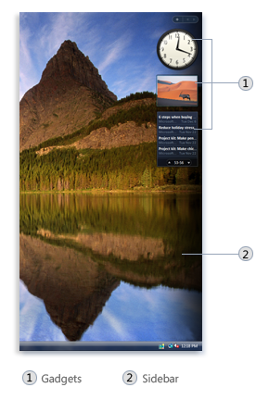
Gadgets
Windows Sidebar is a long, vertical bar that is displayed on the side of your desktop. It contains mini-programs called gadgets, which offer information at a glance and provide easy access to frequently used tools. For example, you can use gadgets to display a picture slide show, view continuously updated headlines, or look up contacts.
Right click desktop to see your gadgets.

Slide 3
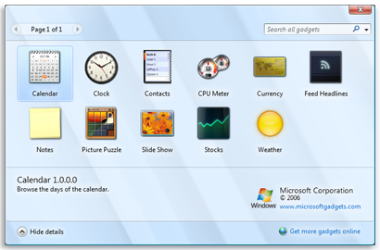
Which gadgets do you have?

Slide 4
Sticky Notes

Slide 5
To create a new sticky note
Open Sticky Notes by tapping the Start button . In the search box, type Sticky Notes, and then tap Sticky Notes in the list of results.
To create additional notes, click the New Note button.
You can also open a new note by pressing Ctrl+N.

Slide 6
To delete a sticky note
When you've finished using a note, you can delete it to clean up your desktop.
Click the Delete Note button.
In the Sticky Notes dialog box, click Yes.
You can also delete a note by pressing Ctrl+D.
To change the color of a sticky note
Right-click the note that you want to change, and then click a color.

Slide 7
To format text in a sticky note
You can format text, add bullets to make a list, or change the text size by using keyboard shortcuts. Here's how:
Select the text that you want to change.
Use the following keyboard shortcuts to format the text on your note:
Type of formatting |  | Keyboard shortcut
Bold text |  | Ctrl+B
Italic text |  | Ctrl+I
Underlined text |  | Ctrl+U
Strikethrough |  | Ctrl+T
Bulleted list |  | Ctrl+Shift+L (Press this keyboard shortcut again to switch to a numbered list.)
Increased text size |  | Ctrl+Shift+>
Decreased text size |  | Ctrl+Shift+<

Slide 8
Pinning Programs
"Pinning" is a great way to add shortcuts to your most-often used programs in Windows 7. You can pin items to the Taskbar, at the bottom of the screen, or to the Start menu. That saves a lot of clicks and makes you more efficient. Once you pin an item, you can also unpin it.

Slide 12
Microcomputers Word Review
Margins (page layout tab)
Page Orientation (page layout tab)
Find and Replace (home tab)

Slide 13
Microcomputers Word Review
Revisions/Comments (Reviewer tab)
Headers/Footers (insert tab)

Slide 14
Create Mail Merged Databases
In Word
Mailings tab, select users, type list
Creates an access database
In Excel
Type headers such as last name, first name, st. address, city, state, and zip
Type data
In Word say use existing list and locate Excel list.
In Access
Create tables with customer fields.
Type data
In Word say use exiting list and locate Access list you want to use. Usually use a query that you creating.

Slide 15
Microcomputers PowerPoint Review
Themes
Handouts-file print, choose full page print to 2 or 3 slides per page.
Open a word document in PowerPoint-change file type to from .ppt to .doc

Slide 16
Header/Footer
INSERT TAB
Click header and
footer
Views
Speaker Notes
Header/Footer
Views

Slide 17
Microcomputers PowerPoint Review
Animations-movement of text or graphics
Edit Animations-Click Animation Tab, click animation pane
Transitions-movement between slides
SmartArt/WordArt-Double click to edit shape or colors

Slide 18
Microcomputers Excel Review
Create formulas using addition (+), subtraction (-), multiplication (*), division(/)
Create a formulas using If, PMT, Average, Minimum, Maximum
Format a worksheet

Slide 19
Summary of Formulas (select cells with mouse)
Sum( ) Total a set of numbers
Count( ) Count the number of cells that have numbers
CountA( ) Count the number of cells that are not empty
Average( ) Average a set of numbers
Min( ) find the minimum value in a set of numbers
Max( ) Find the maximum value in a set of numbers

Slide 20
Total, Average, Min, and Max Practice
Open SummaryFormula
in Cell B19, create a formula that total sales.
In cell B20, create a formula that averages sales
In cell B21, create a formula that tell you the minimum sales
In cell B22, create a formula that tells you the maximum sales.

Slide 21
Payment Practice Paying off a Loan
You want to borrow $150,000 for 30 years at an annual rate of 6%. You will make monthly payments (12 per year), and payments will be at the end of each interest period. The balance at the end of the loan will be $0 (you will completely pay it off). What is your monthly payment?

Slide 22
Solution
Once you realize that what you are trying to find is the regular payment (requiring the PMT function), you need to identify the arguments:
·
present value | "You want to borrow $150,000…" This is how much money you have now: the.
number of periods: | "…for 30 years...monthly payments" These two numbers determine the 30*12 = 360.
rate per period | "…at an annual rate of 6%" This is the annual rate, but there are 12 periods per year, so the rate per period is 6%/12 = 0.5%, or .005.
future value | "…balance at the end of the loan will be $0…" This is the future value of the loan (amount you owe when it is paid off): $0.
Type | "…payments will be at the end of each interest period." Type is "end of period", so use 0.
The PMT arguments are: PMT(rate, nper, pv, fv, type)
So the formula is: =PMT(.005, 360, 150000, 0, 0)

Slide 23
Excel can do this for you.
($8,490.57)

Slide 24
Excel
IF statements
Averageif() Average values that meet one condition
Countif() Count cells that meet one condition
Sumif() sum values that meet one condition
Averageifs() Average values that meet multiple criteria
Countifs() Count cells that meet multiple criteria
Sumifs() Sum values that meet multiple criteria

Slide 25
Open SummaryCondition
Highlight range A2:A38 and name it Category
In cell F2, create a formula to count the number of Berry Bushes products in the cell range A2:A38, which has been defined as the named range Category.
In cell F8, count the number of Flowers products in the Category range that are more than $20.00

Slide 26
In cell F4, sum the value of all Flowers products in the Category range.
In cell F12, add up the cost of all Carnivorous products in the Category range that are less than $7.00.
In cell F6, average the price of all Herbs products in the Category range.
In cell F10, calculate the average cost of Carnivorous products in the Category range that are named Bladderwort.

Slide 27
Conditional Logic in a formula
IF() Return one value if a test is TRUE, and another if the test is FALSE
AND() Return TRUE if all arguments are true
OR() Reture TRUE if any arguments are true.
NOT() Reverse the logical value of the argument.
IFERROR() Return a user-friendly message if a formula has an error due to user input.

Slide 28
Open ConditionalFormula
In cell C25, use the AND function to determine
If the Entertainment total is less than $300.00 and the Misc. total is less than $100.00.
In cell C27, use the IF function to display the test “Expenses OK” if the function in C25 evaluates to True and “Expenses to high” if it evaluates to FALSE.

Slide 29
In cell C26, use the OR function to determine if the Entertainment total is more than $200.00 or the Misc. total is more than $100.00.
In cell C28, use the IF function to display the text “Expenses OK” if the function in C26 evaluates to NOT TRUE and “Expenses too high” if it evaluates to NOT FALSE
Add 60.00 to either the Entertainment column or the Misc. column to check your work

Slide 30
Format or modify text by using formulas Open FormatFormula workbook
Insert two blank columns to the right of the names column.
Select the Names column, and convert to text (choose DATA TAB, click text to columns) to start data wizard.

Slide 32
Excel
Format a worksheet
Page Margins
Page orientation
Column and row widths
Sorting
Charts
Change color of worksheets in a workbook.
Show formulas Ctrl ~

Slide 33
Microcomputers Access Review
Create a table
Create a 1 to many relationship
Create a single-table and a multi-table query

Slide 34
Access
Table Design and enter data
Table Design
Primary Key
Create a Table
Create Forms
Create Query
Create Report

Slide 35
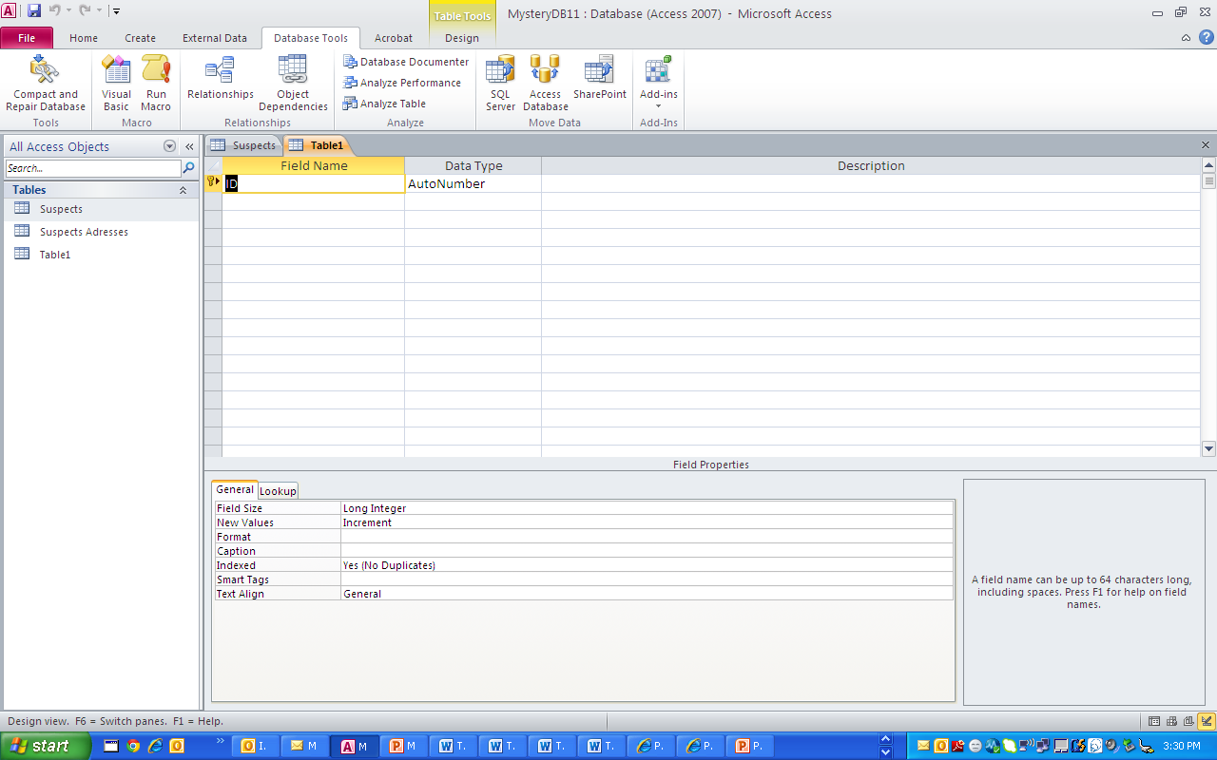
Access
Create a 1-to-many relationship
Create a single-table and a multi-table query

Slide 36
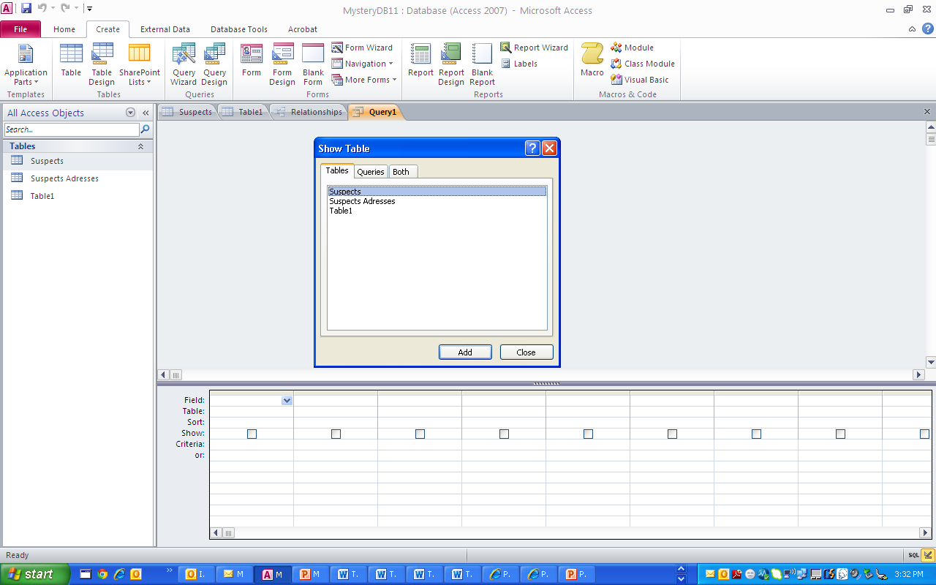
Access
Create a single-table and a multi-table query

