Slide 1

When turkey’s have days off…
They fly around the world.
Alicia Charlton

Slide 2


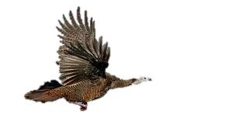

Slide 3
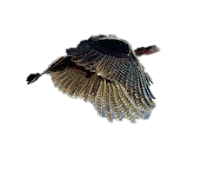

Slide 30


Slide 53
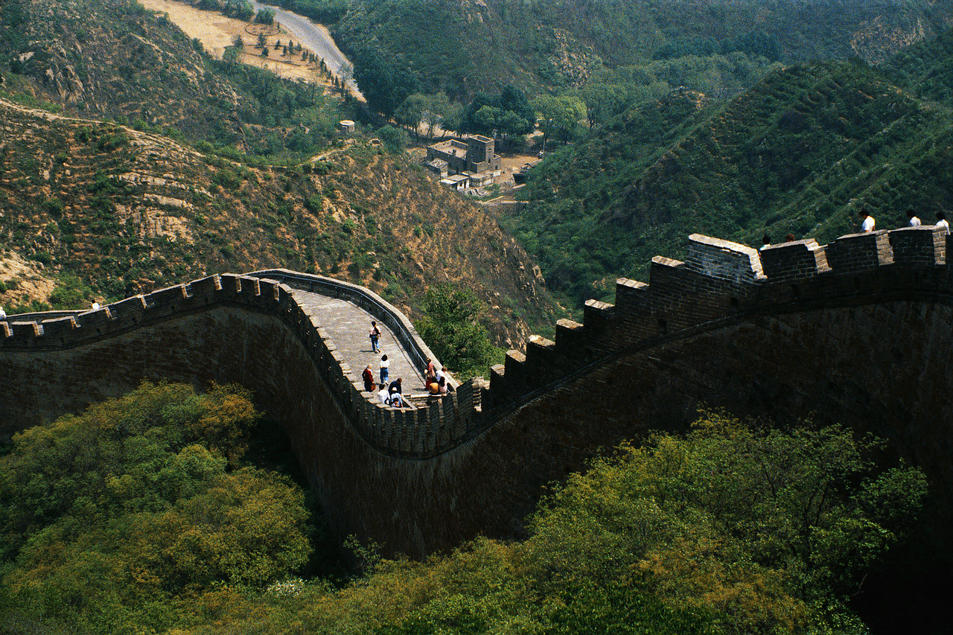

Slide 72
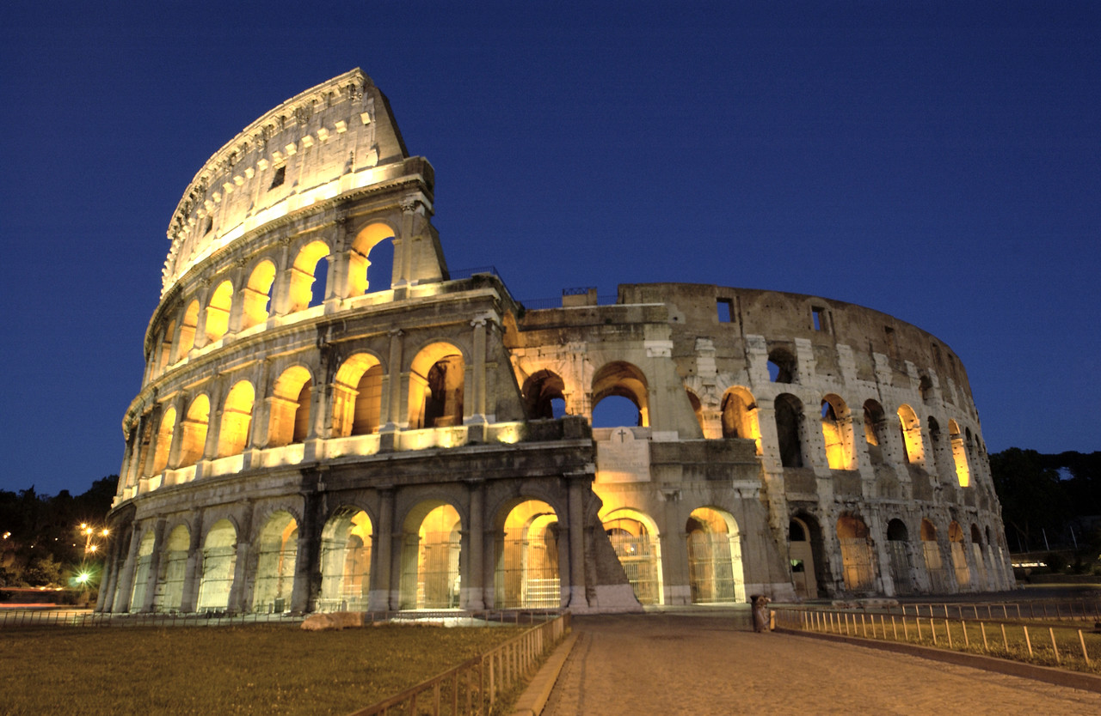

Slide 87
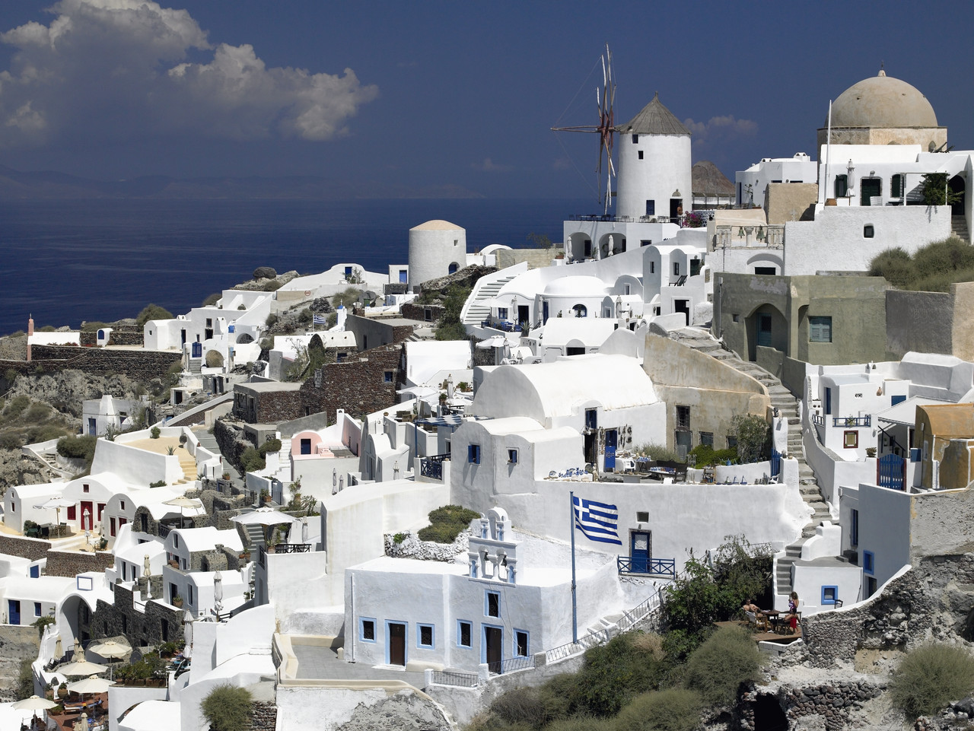

Slide 104


Slide 117
Turkey’s Day Off
Coming to theaters near you
November 22, 2012

