Slide 1
Exam questions

Slide 2
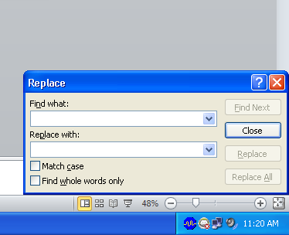
how do you change a word

Slide 3
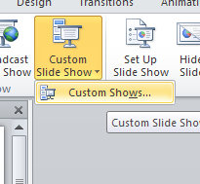
Create custom slide show

Slide 4
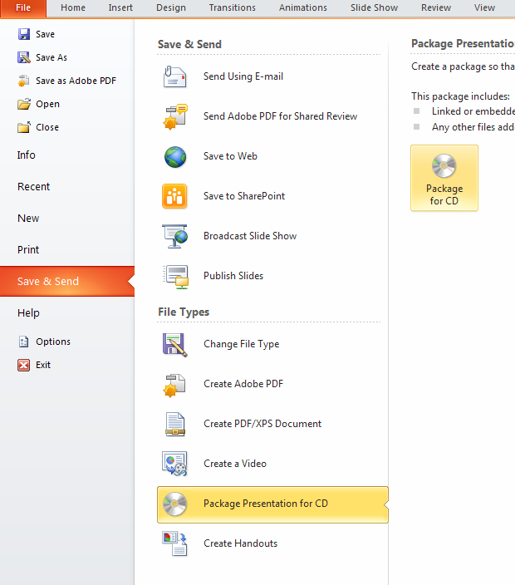
Package your power point as a cd

Slide 5
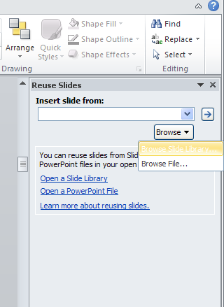
Copy a slide from another slide show

Slide 6
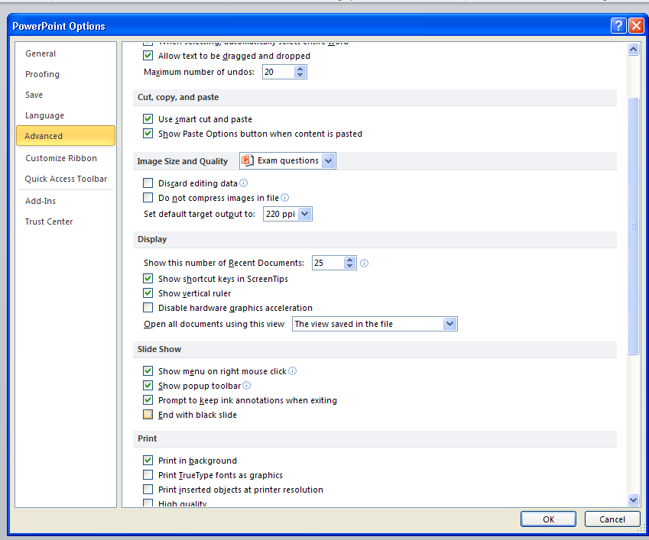
Take off the black slide at the end of a slide show

Slide 7
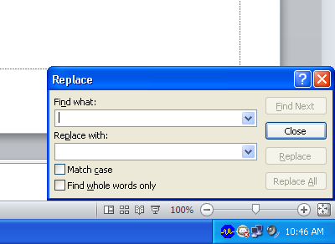
Change the font style and color of the word art

Slide 8
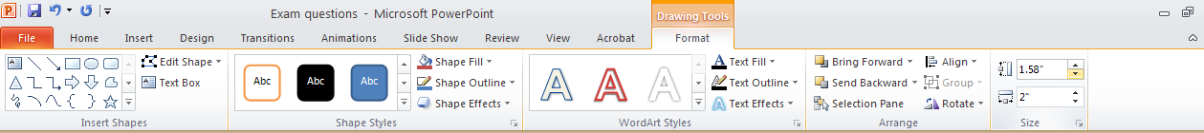
Change the color and size of a shape

Slide 9
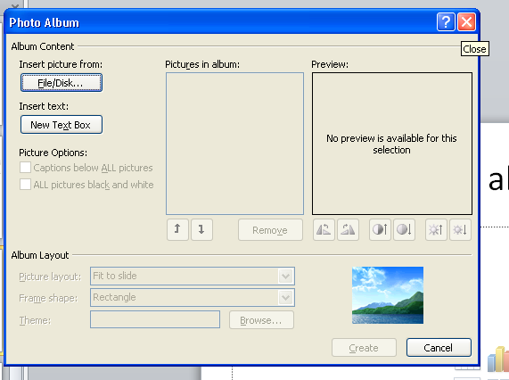
Create a photo album and edit it

Slide 10
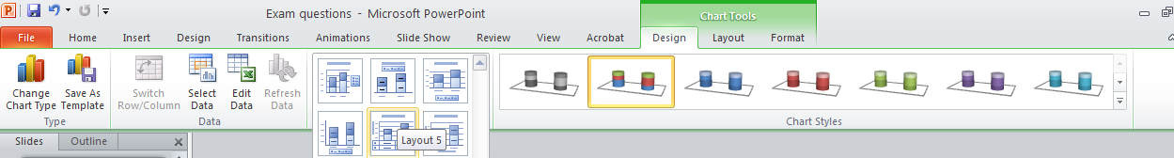
Change the style and layout of a chart

Slide 11
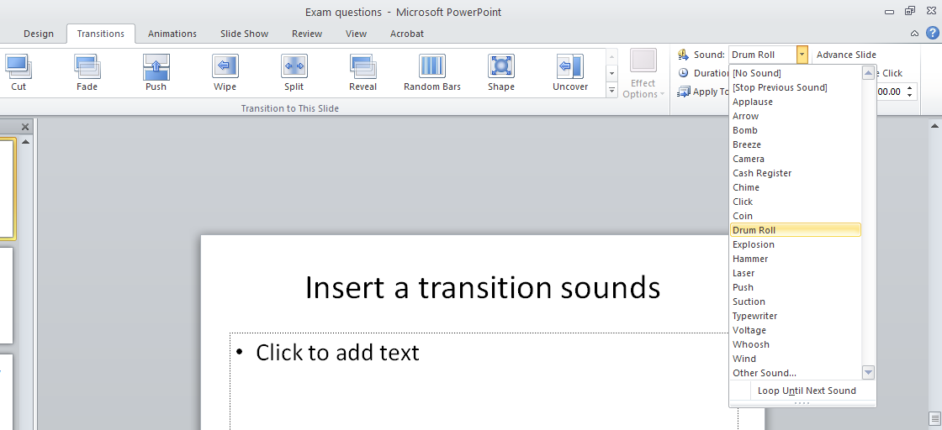
Insert a transition sounds

Slide 12
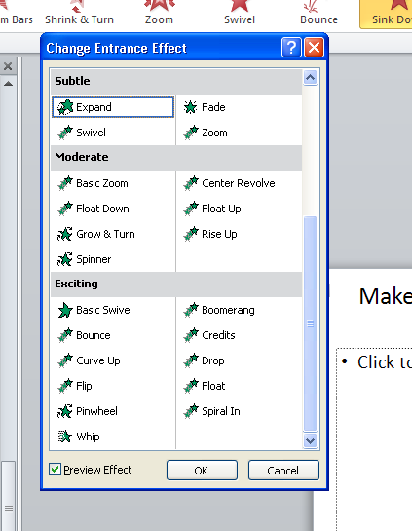
Make the animation effect to move down

Slide 13
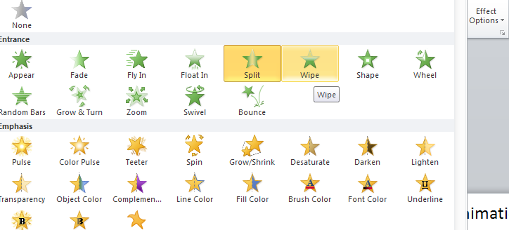
Change the slip animation to a wipe animation and to start after preview

Slide 14
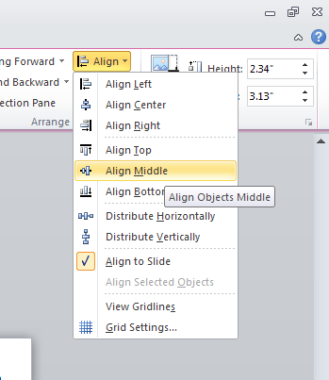

How to reorder a photo top to bottom

Slide 15
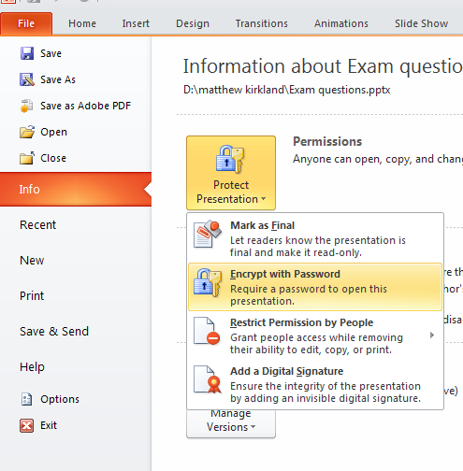
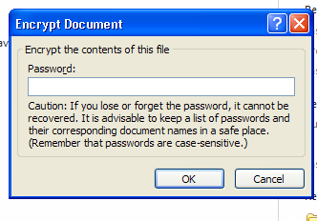
How to add a password to a power point

Slide 16
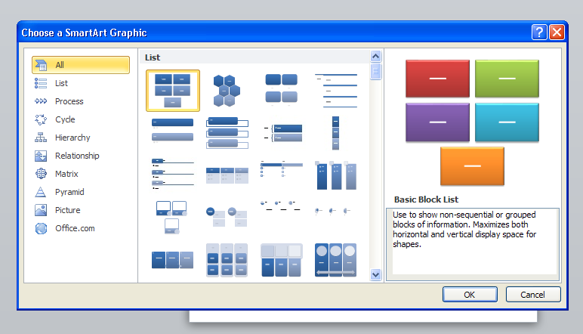
How to add a smart art

Slide 17
How to remove smart art shape

Slide 18
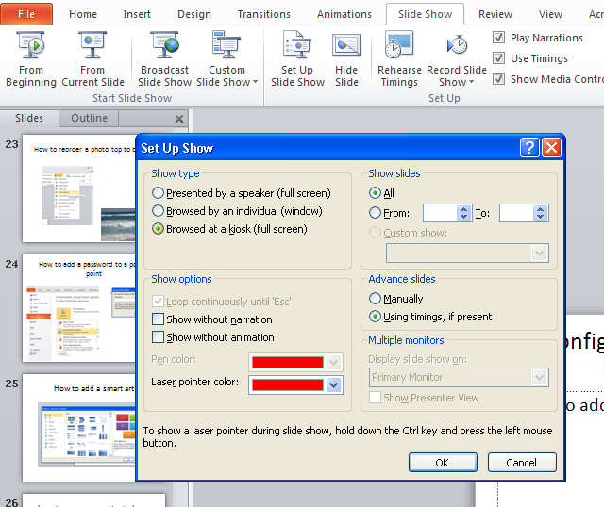
Configure the slide show to be browsed at a kiosk

Slide 19
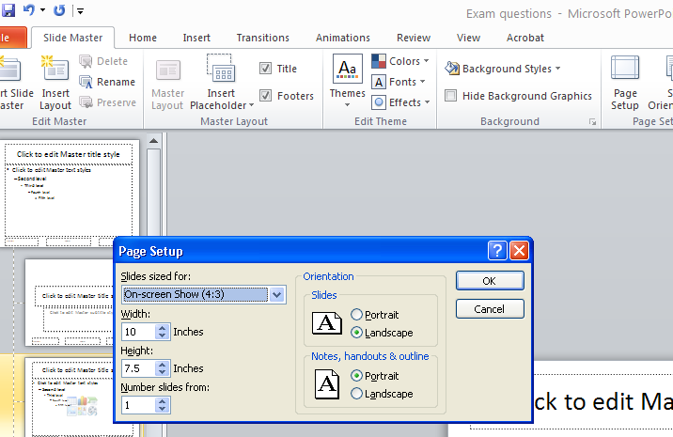
How to set the slide size

Slide 20
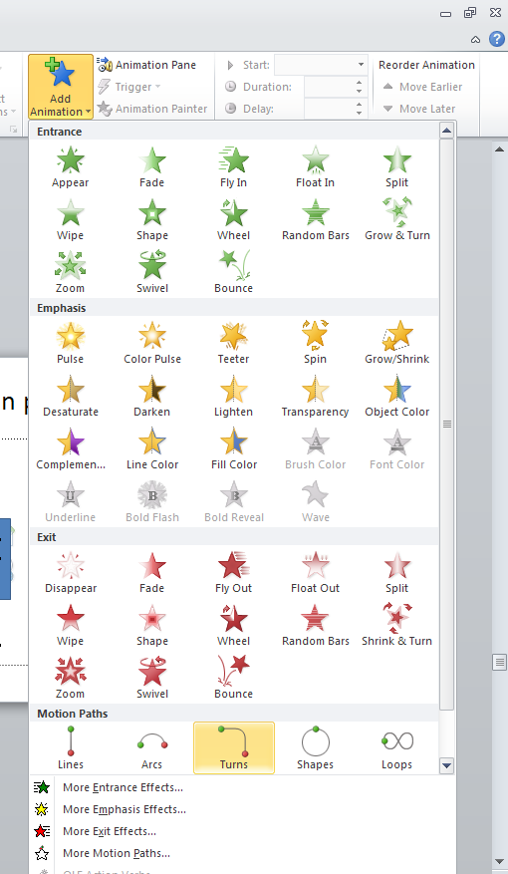
How to create motion path shapes

Slide 21
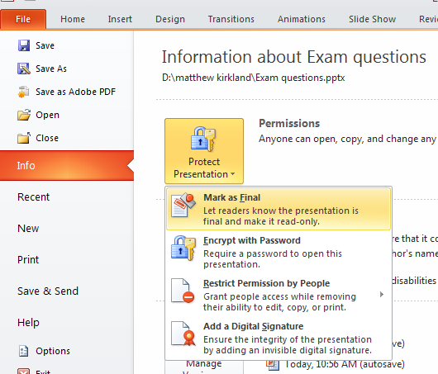
How to mark PowerPoint as final

Slide 22
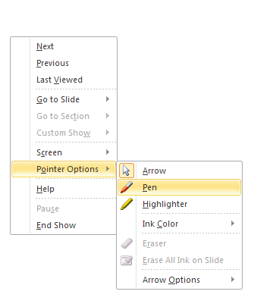
how to change mouse courser from an arrow to a pen

Slide 23
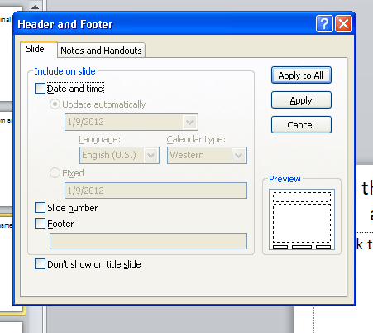
Add the date as the header and name as the footer to every slide

Slide 24
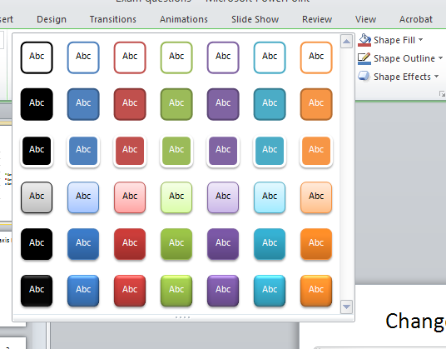
Change the chart style

Slide 25
Decrease the numbers on the y axis by two

Slide 26
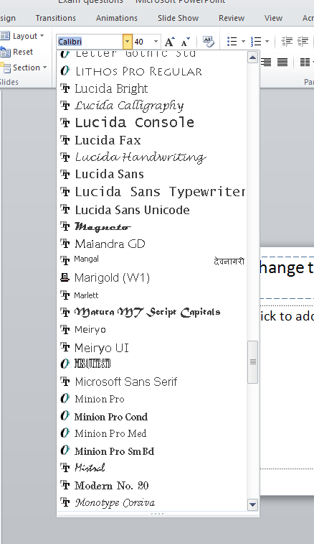
Change the font of text on slide 2 to office classic

Slide 27
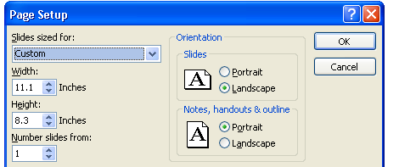
Change view of slide show.
VIEW, SLIDE MASTER, Page Setup

