Slide 1
Digital Design Exam
D
What exam are you taking?
A
B
C
D

Slide 2
Open the Banner
What size is the banner?
750 x 150
750 x 125
800 x 150
700 x 100

Slide 3
How many 100th of a second is state 3 on the animated banner?
19
30
55
79

Slide 4
What marquee was used to feather the image?
Square
Oval
No Marquee
Triangle

Slide 5
What graphics program did you create your animated banner in?
PowerPoint
Paint
Fireworks
Photoshop

Slide 6
Insert the animated banner here and show teacher, I want to see it moving in a slide show.

Slide 7
Open the banner..
What color is the canvas?
  White
  Green
  Red
  Blue

Slide 8
What is the font of animated banner?
Ravie
Harrington
Monotype Corsiva
Brush Script MT

Slide 9
How many states is the animated banner.
28
35
45
51

Slide 10
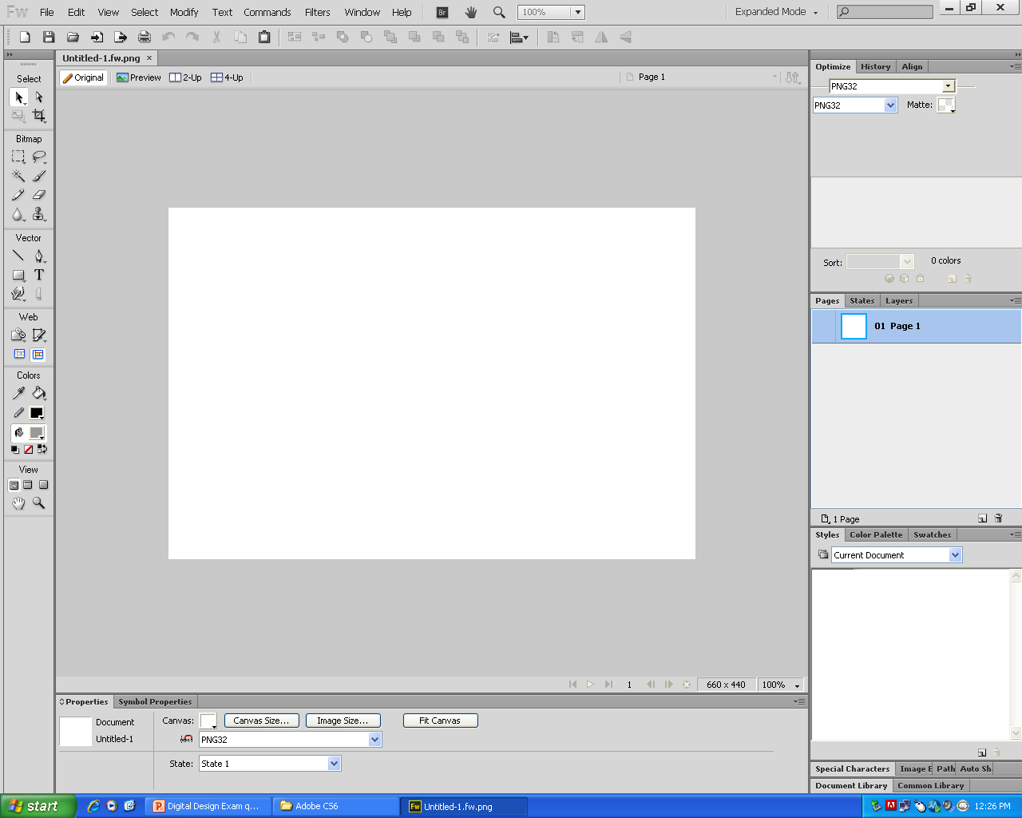
Which tool is used for edit an image to make it smaller?
Crop tool
Pen tool
Marquee Tool
Pointer Tool

Slide 11
Which way is the way to save an editable banner?
File, Save As
File, Image Preview
File, Save
File, Export Preview

Slide 12
If you were going to insert an animated image in a PowerPoint which image would you use?
realestatebanner.png
realestatebanner.gif
realestate
realestate image

Slide 13
Which is the correct way to save your animated banner?
File, Save As
File, Image Preview
File, Save
File, Export Preview

Slide 14
Using the image below and text create a txt to path in Fireworks.
In England once there lived a big And wonderfully clever pig.
To everybody it was plain
That Piggy had a massive brain. He worked out sums inside his head, There was no book he hadn't read. He knew what made an airplane fly, He knew how engines worked and why.
He knew all this, but in the endOne question drove him round the bend:He simply couldn't puzzle out. What LIFE was really all about.
Insert only the outline with text on the next PowerPoint.

Slide 15
Paste the text to path image here and show teacher.

Slide 16

Paste Inside
Using the following shape and paste inside the image. Hint: you can copy the picture below from the PowerPoint, but draw the shape in Fireworksl
Insert the Paste inside on the next slide

Slide 17
Paste the paste inside image here and show teacher.

