Slide 1
Welcome to Photoshop
Good luck!!!

Slide 2
10. Basic Image Editing
Now that you know how to find your way around in the Adobe Photoshop CS6 interface and are familiar with the most common commands, palettes, and tools, you can start some basic image editing. In the next few chapters of this tutorial you will learn how to crop, resize, correct, and sharpen/blur your image.

Slide 3
Chapter 10
Cropping

Slide 4
11. Cropping
Cropping is one of the most basic editing techniques that can improve your images. Cropping helps to bring out the most important features in your image and focus the viewers’ attention on these features. Cropping also allows you to make your image a standard photo size.
There are several ways to crop images in Adobe Photoshop:
1. Cropping with the Crop Tool
2. Cropping to a specific size
3. Cropping with the Marquee Tool

Slide 5
11. Cropping
Cropping with the Crop Tool
The Crop Tool allows you to make a precise selection of an image you wish to edit. To crop with the Crop
Tool, follow these steps:
1. Open the image you wish to crop (http://www.divasanddrooligans.com/item_images/StripeBlueDuck150.jpg)
2. Select the Crop Tool from the Toolbox (see Selection Tools for location and description).
3. It will automatically select your entire image. Drag the edges to fit the dimensions you desire.

Slide 6
11. Cropping
Here is an example of what you are doing.

Slide 7
11. Cropping
Cropping to a specific size
If you wish to print your digital photos or other images on standard size photo paper, you will have to crop your images to a specific size, such as 8x10. To crop an image to a specific size, do the following:
1. Open the image you wish to crop.
2. Select the Crop Tool from the Toolbox.
3. In the Options bar, specify the values for Width and Height (Figure 13).

Slide 8
11. Cropping
4. Click in your image and drag the cropping border. Notice that the border is constrained. You cannot make it wider or longer than the specified values (Figure 14). For example, if you entered 8 for Width and 10 for Height, whatever size you make the border, the area within it will fit on an 8x10 photo.

Slide 9
11. Cropping
5. Once you are completely satisfied with your cropped image, press Enter.
Cropping with the Marquee Tool
If you are in a hurry and need just a simple crop, you can use the Marquee Tool and a menu command. To crop with the Marquee Tool, follow the steps below:
1. Open the image you wish to crop.
2. Select the Rectangular Marquee Tool from the Toolbox (see Selection Tools).
3. Click and drag the mouse to draw a marquee around the area you wish to crop (Figure 15).

Slide 10
11. Cropping
4. In the main menu, go to Image > Crop (Figure 16). The image will be immediately cropped

Slide 11
Chapter 12
Resizing

Slide 12
12. Resizing
19 Resizing in Photoshop can help you print your images in standard photo sizes, resize and preserve the high quality of digital photos, and enlarge small images to a poster size.

Slide 13
12. Resizing
Resizing to a specific size
To resize your image to a preset size, follow the steps below:
1. In the main menu, go to File > New.
2. In the New dialog box, click on the Preset dropdown menu. You will see several preset sizes, such as 2x3, 4x6 and 5x7. Remember that 72 ppi is fine for online images, but a ppi of 150-300 is better for printed images. (Figure 17).

Slide 14
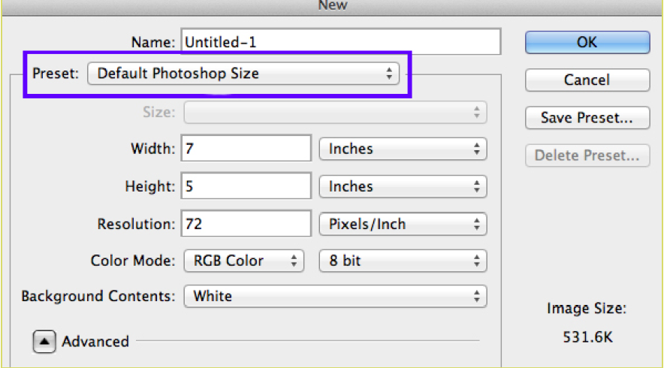
12. Resizing
3. Choose the size that you wish and click OK.
Note: All the preset sizes are in portrait orientation. If you wish to resize an image with the landscape orientation, you need to create your own preset. To create your own size, do the following:
1. Type in the values for Width and Height, for example 7x5.
2. Type in your desired resolution (150 ppi for high quality prints, and 72 ppi is good for web images).
3. Click the Save Preset button

Slide 15
12. Resizing
Resizing digital photos
Digital photos usually have large dimensions but low resolution, 72 ppi, which affects their quality when their size is decreased or increased. When printed, the photos with the changed size will look pixilated. To resize the digital photos without loosing the quality, follow these steps:

Slide 16
12. Resizing
1. Open the digital photo you wish to resize.
2. In the main menu, go to View > Rulers. You will see the dimension of your photo (Figure 18).

Slide 17
12. Resizing
3. In the main menu, go to Image > Image Size.
4. In the Image Size dialog box, check the Resample Image box off (Figure 19). Type in your desired resolution (anything between 150 and 300 ppi). The photo is now 3.208 x 3.083 inches.

Slide 18
12. Resizing
Enlarging
If you want to make your digital photo into a poster size image, you can do it in the Image Size dialog box. However, just increasing the dimensions will make the image appear blurry and pixilated. To enlarge the image without losing the quality, follow these steps:

Slide 19
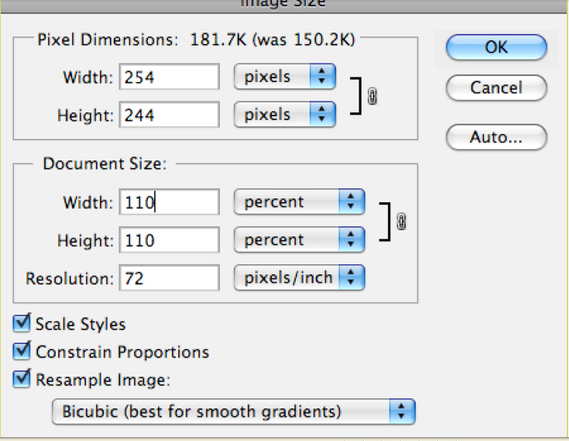
12. Resizing
1. Open the digital image you wish to enlarge.
2. In the main menu, go to Image > Image Size.
3. In the Image Size dialog box, make sure the Resample Image box is checked off and choose Bicubic Smoother from the dropdown box (Figure 20).
4. Change the Document Size measurements to Percent. Type in 110. This will increase the size of the
image by 10 percent (Figure 20).
5. Continue enlarging by 10 percent until you are satisfied with the size.

Slide 20
Chapter 13
Correcting

Slide 21
13. Correcting
Digital cameras tend to cause various problems, such as “red eye” or “hot spots”, if you use flash, or underexposure, if you don’t. In Photoshop, you can correct these problems, as well as adjust the overall color of your digital photo.

Slide 22
13. Correcting
Red Eye Removal
The digital camera flash is located right above the lens, which causes the “red-eye”; however, you can fix your photos easily in Photoshop. To remove the “red eye”, follow the steps:
1. Open a photo you wish to correct. (http://upload.wikimedia.org/wikipedia/commons/b/b3/BoldRedEye.JPG)
2. Select the Zoom Tool from the Toolbox. Click and drag a rectangle around the eye (Figure 21).

Slide 23
13. Correcting
3. Make sure your default Foreground and Background colors are black and white.
4. Click and hold on the little black triangle of the Healing Brush Tool button and select the Red Eye Tool

Slide 24
13. Correcting
5. Click on the red part of the eye and paint, holding down the mouse button. You will see how the red will disappear

Slide 25
13. Correcting
Hot Spot Removal
Using a flash can also cause shiny areas on peoples’ faces or the flash to reflect on shiny surfaces. To correct this problem, follow the steps below:
1. Open the photo you wish to correct.
2. Select the Clone Stamp Tool from the Toolbox.
3. In the Options bar, change the Blend Mode from Normal to Darken

Slide 26
13. Correcting
4. Set the Opacity to 50 percent.
5. Choose a soft-edged brush, set the diameter to 40 or 50.
6. Hold down the Shift key and click in the clean area (without “hot spots”) to get a sample of color.
7. Paint over the “hot spot”, the light area will gradually darken

Slide 27
13. Correcting
Adding Flash
If you took pictures indoors without a flash, they will turn out underexposed and dark. To fix underexposed photos, follow these steps:
1. Open a digital photo you wish to correct

Slide 28
13. Correcting
2. In the main menu, go to Layers > Duplicate. In the next window, name the layer Layer 1.
3. Make sure Layer 1 is selected in the Layers palette. Select Image from the menu, select Adjustments and select Exposure (Figure 28). Select the amount of exposure. The whole image will lighten.

Slide 29
13. Correcting
4. Keep duplicating Layer 1 until you are satisfied with the your image

Slide 30
13. Correcting
Color Adjustment
Color adjustment options in Photoshop CS6 can help you to make your digital photos look more natural. To color correct your images, follow these steps:
1. Open the image you wish to correct.
2. In the main menu, go to Image > Adjustments > Levels. You will see a dialog box displaying a diagram of the colors in your image (Figure 30). The black triangle is for shadows, the gray is for mid-tones, the white is for highlights. In the Channels dropdown menu, you can choose between RGB. These indicate whether your changes effect all the colors, or just one (red, green, or blue).

Slide 31
13. Correcting

Slide 32
13. Correcting
3. Make sure the Preview box is checked off. Choose the channel you wish to change and drag the triangles. Dragging the black triangle to the right will make the shadows in your photo darker. Dragging the white triangle to the left will make the highlights in your photo lighter, and dragging it to the right will make the mid-tones darker. You will be able to see the changes in your image. Figure 31 shows an underexposed photo. By correcting the highlights and making the image lighter, we are able to make the photo appear much brighter

Slide 33
13. Correcting
Underexposed photo
(Before)
Corrected photo
(After)

Slide 34
Chapter 14
Rotating

Slide 35
14. Rotating Images
Rotating images
There may be times when you open an image in Photoshop to find that it is not in its proper orientation. Alternatively, a photograph that you have taken is just a little bit crooked. There are easy ways to fix both of these situations.

Slide 36
14. Rotating Images
To rotate an image:
The Image Rotation commands let you rotate or flip an entire image. The commands do not work on individual layers or parts of layers, paths, or selection borders. If you want to rotate a selection or layer, use the Transform or Free Transform commands.
1. Choose Image > Image Rotation (Figure 4), and choose one of the following commands from the submenu:
• 180° Rotates the image by a half-turn.
• 90° CW Rotates the image clockwise by a quarter turn.
• 90° CCW Rotates the image counterclockwise by a quarter-turn.
• Arbitrary Rotates the image by the angle you specify. If you choose this option, enter an angle between 0 and 359.99 in the Angle text box. Select °CW or °CCW to rotate clockwise or counterclockwise. Then click OK.
2. Choose File > Save to save the rotated image

Slide 37
Chapter 15
Reducing and image’s size (pixel dimensions)

Slide 38
15. Reducing an image size
Reducing an image’s size (pixel dimensions)
Although you will often want to keep pixel information, sometimes you need to reduce the total (pixel) size of an image. This step removes pixels and reduces file size. You will usually do this when preparing the image for the web or other electronic medium; for print, you will generally want to simply change the document’s size. (Of course, you may want to reduce file size for other reasons, such as to preserve hard disk space or to speed up image rendering.)

Slide 39
15. Reducing an image size
1. Choose Image > Image Size. The Image Size dialog box opens (Figure 3). In the previous steps you attended only to the resolution, or document size of the image. This time you will ignore that area and focus on the pixel dimensions.
2. Select the Resample Image option near the bottom of the dialog box. Observe that the Pixel Dimensions menus and the Constrain Proportions option become active. This option automatically changes the width as you change the height, and vice versa. For example, if you start with an image of 2000-pixel width and 1000-pixel height (a 2:1 width/height ratio) and change the width to 1000 pixels, the height automatically changes to 500 pixels when Constrain Proportions is checked. Generally, selecting this option is a good idea.
Note: You can ignore Scale Styles for now. This option comes into play only when you have styles applied to layers.

Slide 40
15. Reducing an image size
3. Choose Bicubic Sharper from the Resample Image menu. This option is best for reductions.
4. In the Pixel Dimensions Width box, enter the desired width in pixels. You can also choose a percentage by changing the unit beside the Width box from Pixels to Percent.
5. Click OK to change the image’s pixel dimensions.
Note: After the size reduction, you should apply the Unsharp Mask filter to the image by choosing Filter > Sharpen > Unsharp Mask. This will clear up any blurriness that results from the reduction.

Slide 41
Vocabulary!
Pixel dimensions of a bitmap image is a measure of the number of pixels along an image’s width and height.
Resolution is the fineness of detail in a bitmap image and is measured in pixels per inch.
Ppi- Pixels Per inch

