Slide 1
DESE Photoshop Workshop
March 2011
Workshop created by Tonya Skinner, Jackson High School
Permission granted for classroom use by teachers

Slide 2
Part A: Preparation
Task—Create adjustments to existing photographs that will be used on the poster.

Slide 3
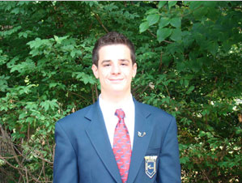
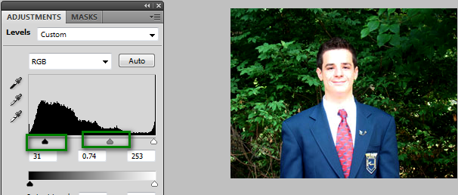
Adjustment Layers
Levels– adjust shadows, midtones, and highlights

Slide 4
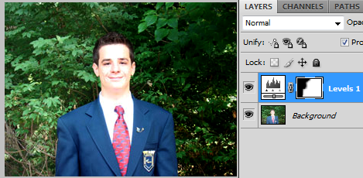
Restricting Adjustments
Paint on the mask in black to take areas out of the adjustment (return those areas to normal)
Notice that left half was adjusted back to normal and right half had not been adjusted yet and remains dark

Slide 5
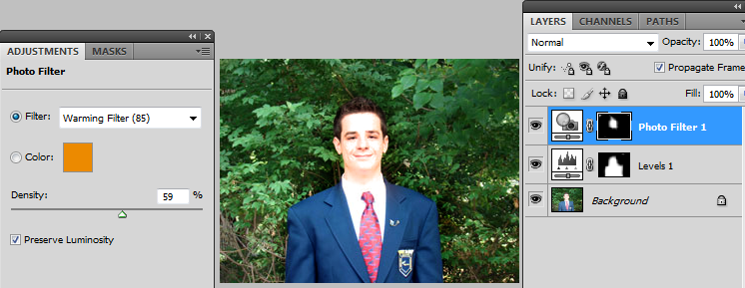
Dealing with Skin
Watch for cold or warm overtones to a picture; if cold (bluish), add a warming filter and if warm (orangish), add a cooling filter adjustment
Adjust by painting so leaves are not orangish

Slide 6
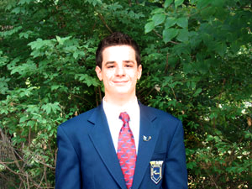
Before & After

Slide 7
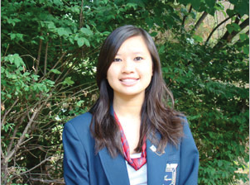
Adjustment Layers

Slide 8
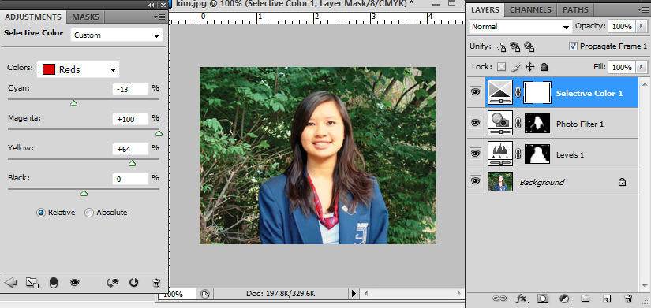
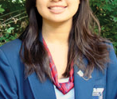
Selective Color
Increase intensity of reds
Before

Slide 9
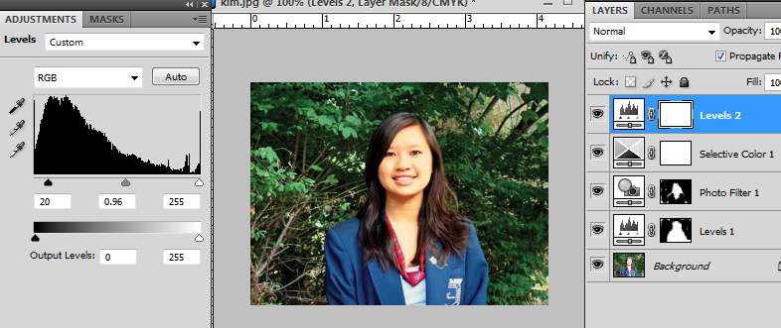
Overall Levels Adjustment
Always a good idea for a final step…
Before

Slide 10
Part B: Document Setup
Task—Create suitable document properties for the project.
Size
Resolution
Background color

Slide 11
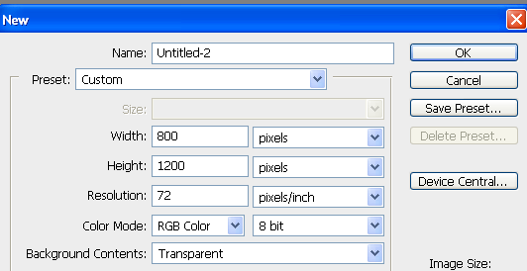
File>New
Setup

Slide 12
Use paint bucket to fill background

Slide 13
Create new layer and name layers

Slide 14
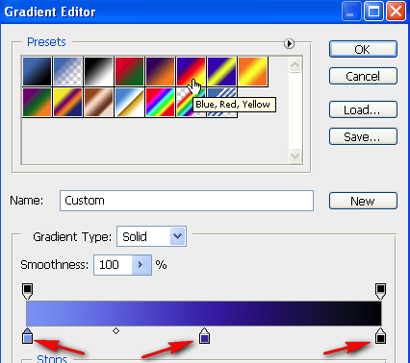
Gradient Fill
Options bar—click gradient editor
Gradient→

Slide 15
Draw the Gradient

Slide 16
Part C: Brushes/Blending Modes
Task—Load brushes and modify blending modes for effect

Slide 17
Create new layer

Slide 18
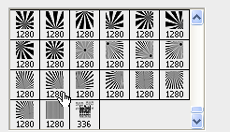
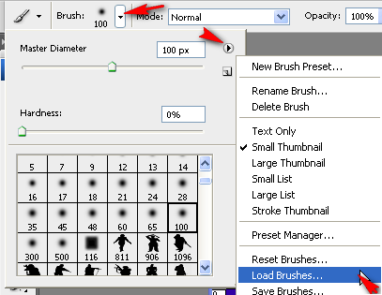
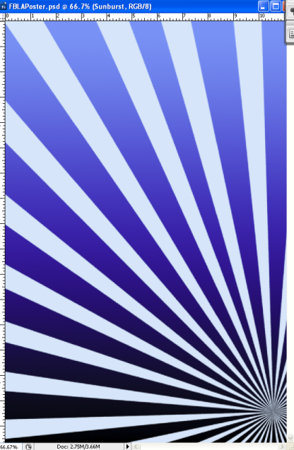
Brush tool/Load brushes
Risingsun Brushes by Blazter

Slide 19
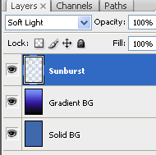
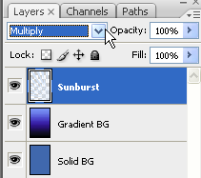
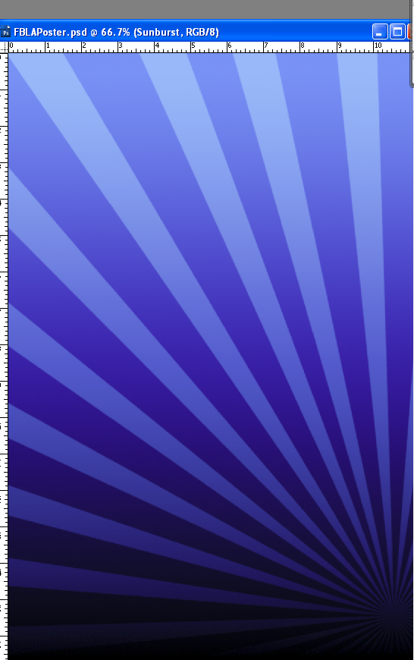
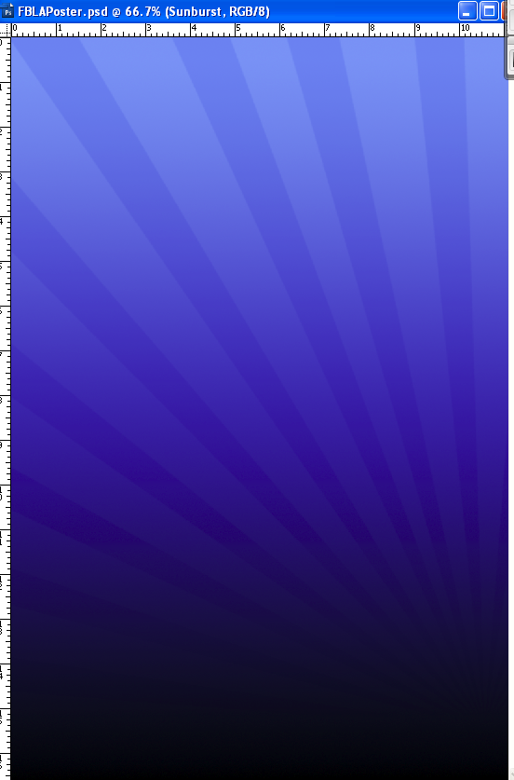
Blending Modes
Change blending mode using the Layers palette

Slide 20
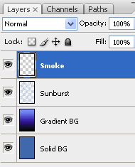
Load More Brushes…

Slide 21
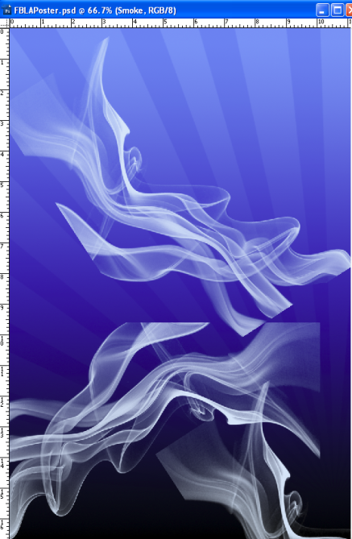
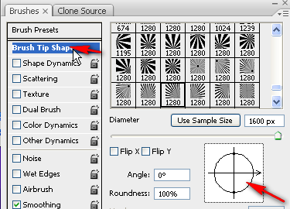
Brushes Palette
Window>Brushes
Set Brush Tip Shape and drag in the rotation box to rotate the brush to the desired angle

Slide 22
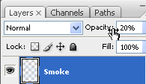
Layer Transparency
Change Opacity slide in Layers Palette (top right) to 20%

Slide 23
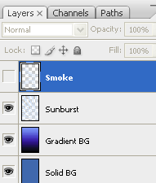
Turn off Layer Visibilty
Pick one to keep and turn the other one off (smoke or sunburst)

Slide 24
Part D: Create Type, Transformations, and Apply Styles
Task—Create type and modify paragraph settings
Task—Apply various transformations
Task—Apply layer styles

Slide 25
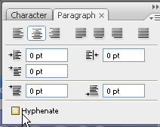
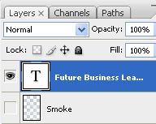
Type
Toggle Character palette
Accept

Slide 26
Rotate and Blending Mode
Control+T for handles

Slide 27
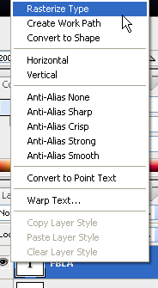
Add Text and Rasterize Type

Slide 28
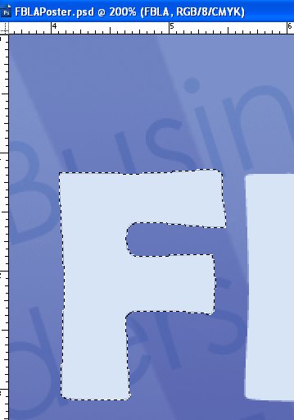
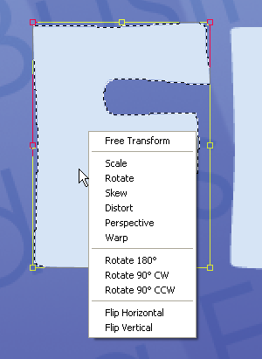
Select Letter with Magic Wand
Control+T; right click for options

Slide 29
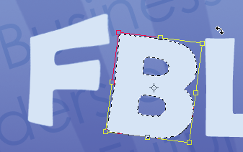
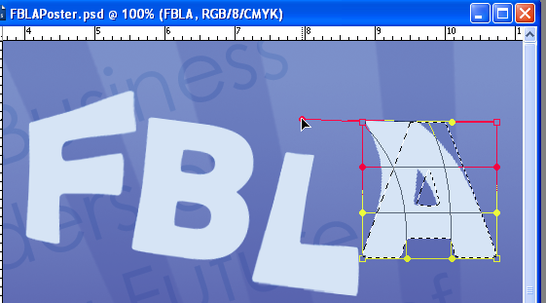
Transform
Distort
Warp
Perspective

Slide 30
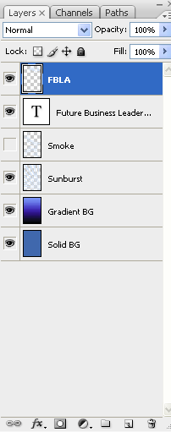
Checkpoint

Slide 31
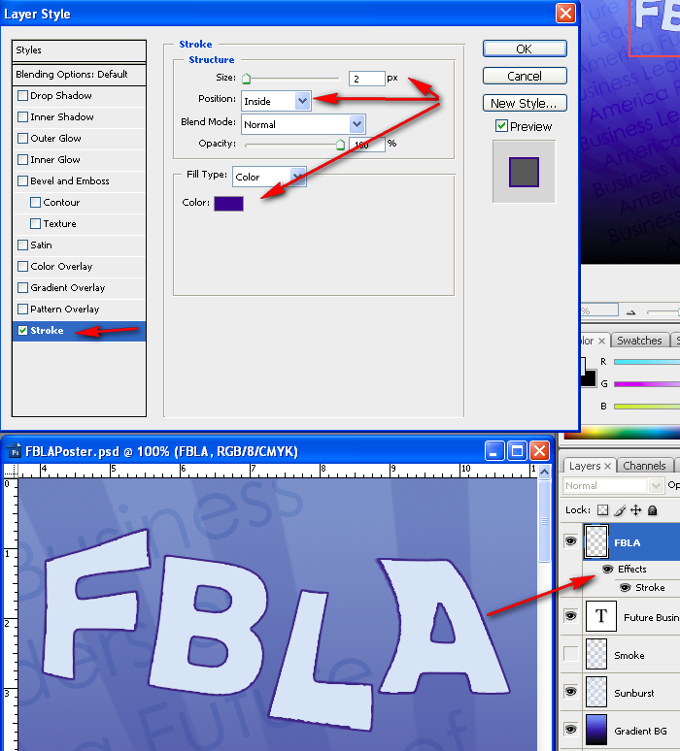
Layer Styles

Slide 32
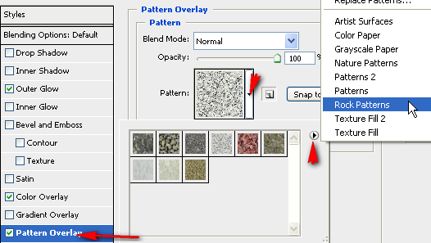
More Layer Styles
Double click Effects below the layer to edit/add more styles
Add pattern overlay—have to choose more patterns…

Slide 33
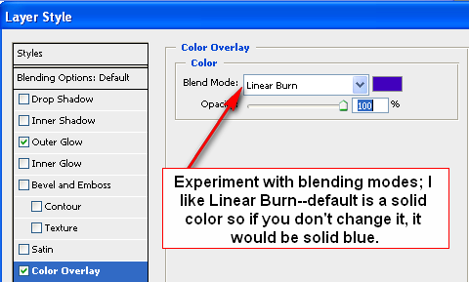
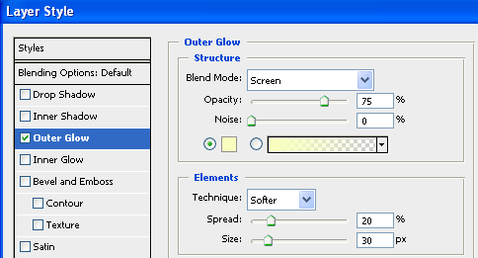
And More…

Slide 34
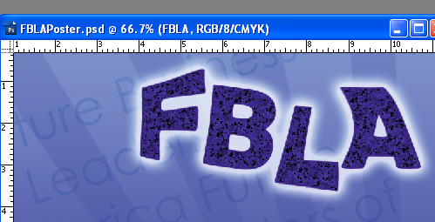
Completed Heading

Slide 35
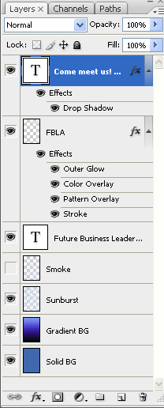
More Type

Slide 36
Part E: Layer Groups
Task—Organized Layers palette with layer groups

Slide 37
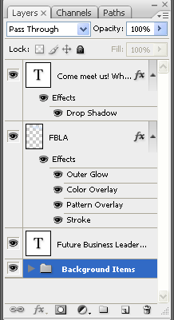
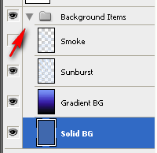
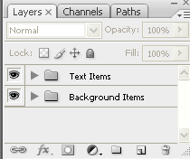
Layer Groups
Click Create New Layer Group
Name it
Select relevant layers and drag them in…
Repeat

Slide 38
Part F: Selections
Task—Make selection using the Quick Selection tool
Task—Refine selections using Quick Mask mode

Slide 39
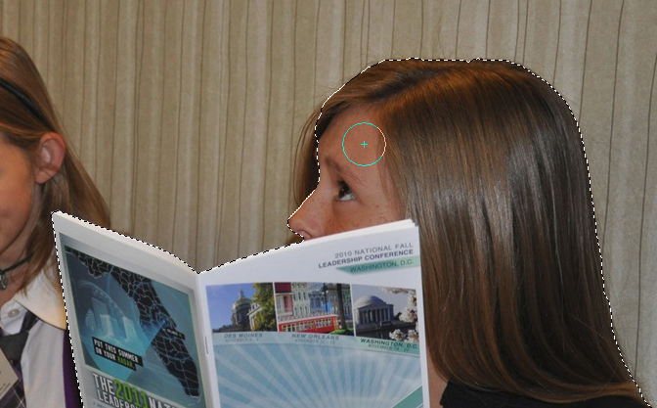
Quick Selection
It’s a brush you can use to magically select things; click and drag over an area

Slide 40
You Won’t Get It All…
Small areas are hard to reach…modify brush size or use a different tool (Polygonal lasso set to “add to selection” is useful for getting pointy parts)

Slide 41
Quick Mask
Allows you to select with a paint brush by painting in white
Allows you to “deselect” parts by painting in black
Shows a red overlay in the non-selected region

Slide 42
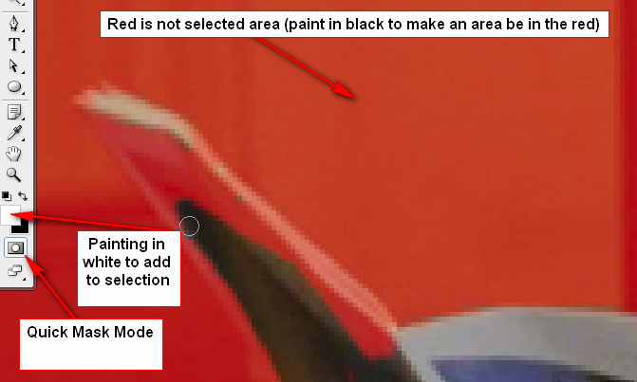
Quick Mask

Slide 43
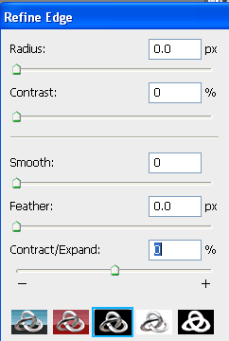
Quick Mask
After selecting, press Q or press the Quick Mask button again to go back to “marching ants” selection mode
Click any selection tool
Then, use REFINE EDGE on the options bar to check the selection
Start with all set at zero
Check on black and white

Slide 44
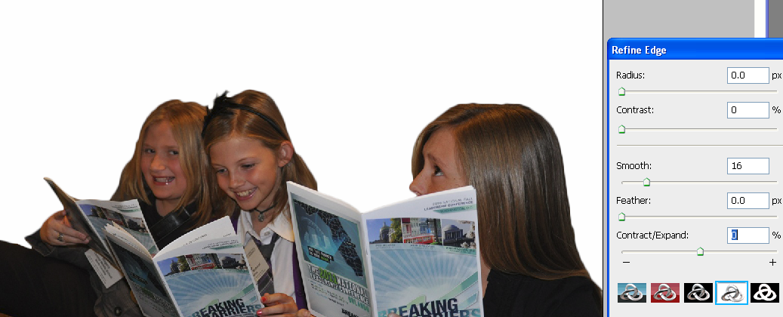
Refine Edge
Checking on white… increased smooth.

Slide 45
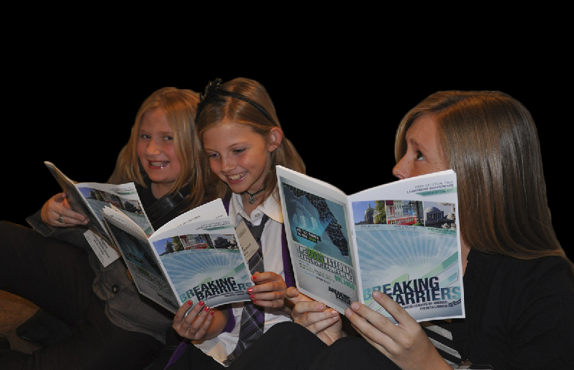
Refine
Checking on black… looks good
Press OK to finalize selection

Slide 46
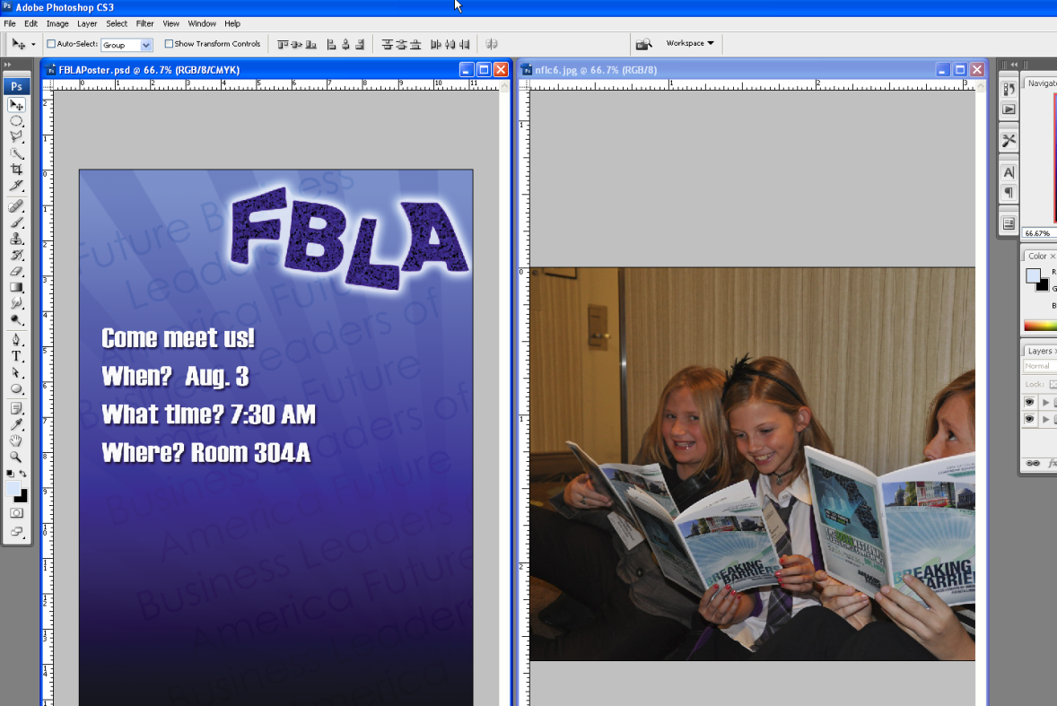
Tile Windows
Window> Arrange> Tile Vertically

Slide 47
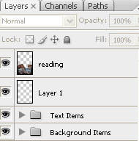
Move Tool—Drag Over
Create a new blank layer before dragging so they don’t go inside a folder
Rename girl layer reading

Slide 48
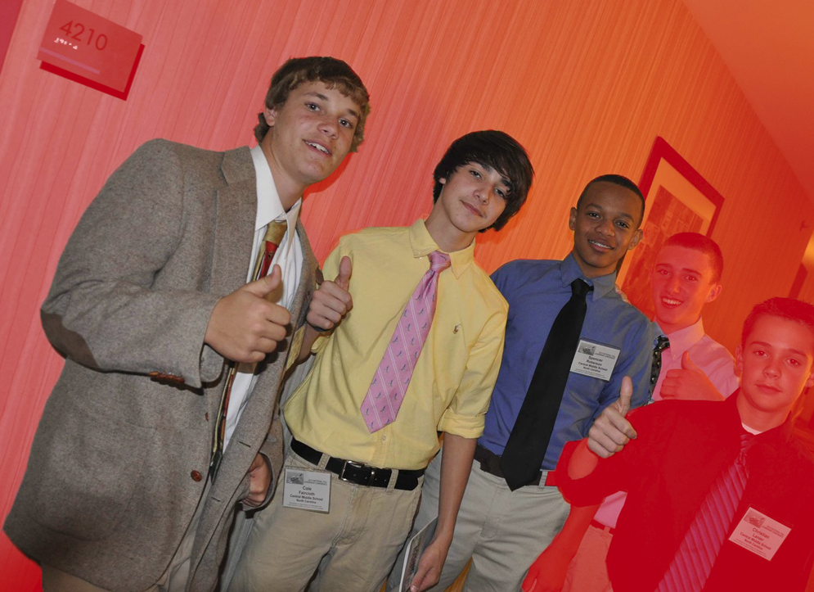
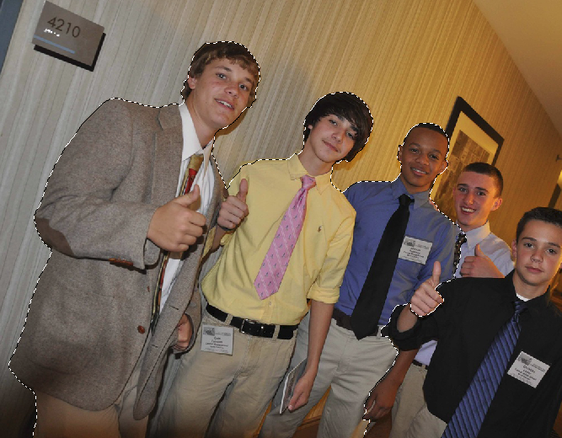
Select

Slide 49
Move Tool
Move over
Control+T and size down (hold Shift in corner)
Reposition layer
Rename layer--boys

Slide 50
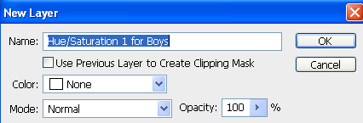
Adjustment: Hue/Saturation
Click on the boys layer; add a Hue/Saturation Adjustment layer
Layer> New Adjustment Layer> Hue/Sat
Check that box or the whole image will turn blue!

Slide 51
Adjustment: Hue/Saturation
Change Hue to blue and Saturation to whatever you like
BE SURE COLORIZE IS CHECKED~!

Slide 52
Layer Style
Boys layer—Inner Shadow

Slide 53
Marquee/Feather
Use marquee to select (no feather)
Use Refine Edge to feather

Slide 54
Move Over
Zoom out, transform, and position as shown.
Name layer and move to top of layer stack.

Slide 55
Adjustment—Black/White
Layer> New Adjustment Layer> Black and White
Check to create clipping mask
Click on layer mask (white box) to edit

Slide 56
Adjustment—Black/White
Using a SOFT black paintbrush, “paint out” the areas that should be in color (the sign and the people)

Slide 57
Checkpoint

Slide 58
Part G: Pen Tool
Task—Create original shapes using the Pen Tool

Slide 59
Pen Tool
Shape layers
Click, let go, drag, click, let go, drag… (or you can click and drag and crazy curves happen) until you get back to the starting point:

Slide 60
Pen Tool
Edit if needed with Direct Selection tool (white arrow)
Draw another!

Slide 61
Layer Style
Add standard drop shadow and white 3px inside stroke

Slide 62
Part H: Placing Images and Clipping Masks
Task—Place edited images
Task—Constrain images to a shape using clipping masks

Slide 63
Clipping Mask
To clip an image into a shape, the image goes above the shape (however, I always put them out of order first so I can make sure the shape is in the right spot)

Slide 64
Clipping Mask
Hold Alt and click on the little line between layers; a little black padlock appears

Slide 65
Part I: Masking Layers
Task—Create layer masks to “hide” parts of a layer

Slide 66
Layer Mask
Select and move in image:
Place as shown
Add a Layer Mask and rename layer:

Slide 67
Layer Mask
Black is like an eraser (but reversible, so it’s better!! Eraser=bad!)
Click ON the mask first
Use soft black brush to blend/erase

Slide 68
Adjustment: Hue/Saturation
Add Hue/Saturation Adjustment layer and tint (colorize) to blue:
Layer> New Adjustment Layer> Hue/Sat (use clipping!)

Slide 69
Part J: Final Touches
Task—Duplicate layer
Task—Reposition layers for final layout

Slide 70
Magic Wand
Select the red part of the flag:
Move over…
Position/size:

Slide 71
Duplicate Layer
Make a copy of the logo layer

Slide 72
Gradient Overlay Layer Style
Left side light blue, right side dark blue
Add drop shadow

Slide 73
Reposition Layer
Move the Text Items layer group to the top of the stack
Then, move the Future Business Leaders layer out of Text Items and into Background Items (top of list)

Slide 74
Finished Poster

