Slide 1
Photoshop
Lesson 2

Slide 2
Open Adobe Photoshop
Open the file named ps0201.psd

Slide 3
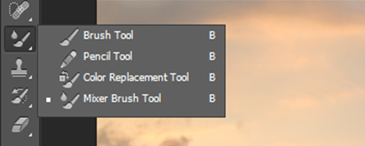
Click and hold the brush tool
Select the hidden Mixer Brush
Click once on the foreground color at the bottom of the tools panel
click and drag up in the color pane until shades of orange appear
Click in the color pane to select any orange color.

Slide 4
Type into the text field for the values of RGB
R:236 G: 169 B:24
In the options bar, click on the Brush preset picker button and set the following attributes:
Size: 175 px
Hardness 20%

Slide 5
Click once on the useful mixer brush combinations drop-down menu and select the Moist, Light Mix preset.
Press CTRL+0 (Zero)

Slide 6
With the mixer brush tool selected, start painting in the upper-left area of the image to create a shade of orange blending in from the corners. Repeat this for each corner of the image.

