Slide 1
Photoshop CS6
Lesson 1

Slide 2
Exploring Photoshop CS6
Starting up
Open Photoshop CS6
Choose file -> Browse in Bridge -> Find ps01lesson on local disk D -> open folder double click and open file called ps0101.psd. An image of a skier should appear.
Choose file -> save as > save it as ps0101_work-> click save

Slide 3
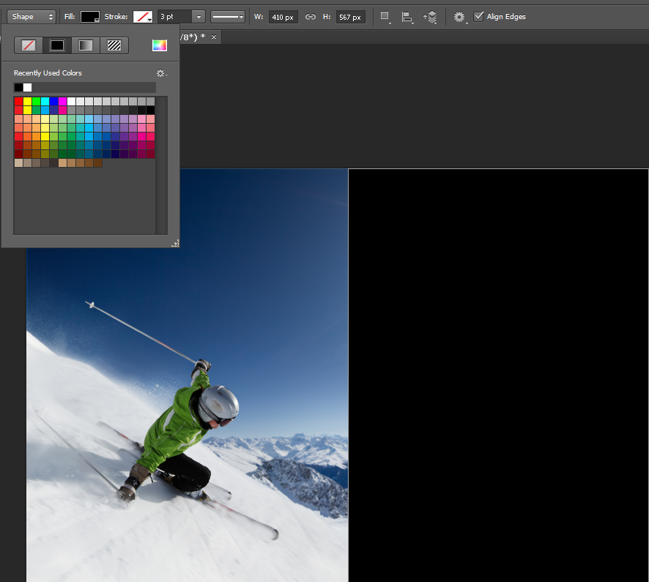
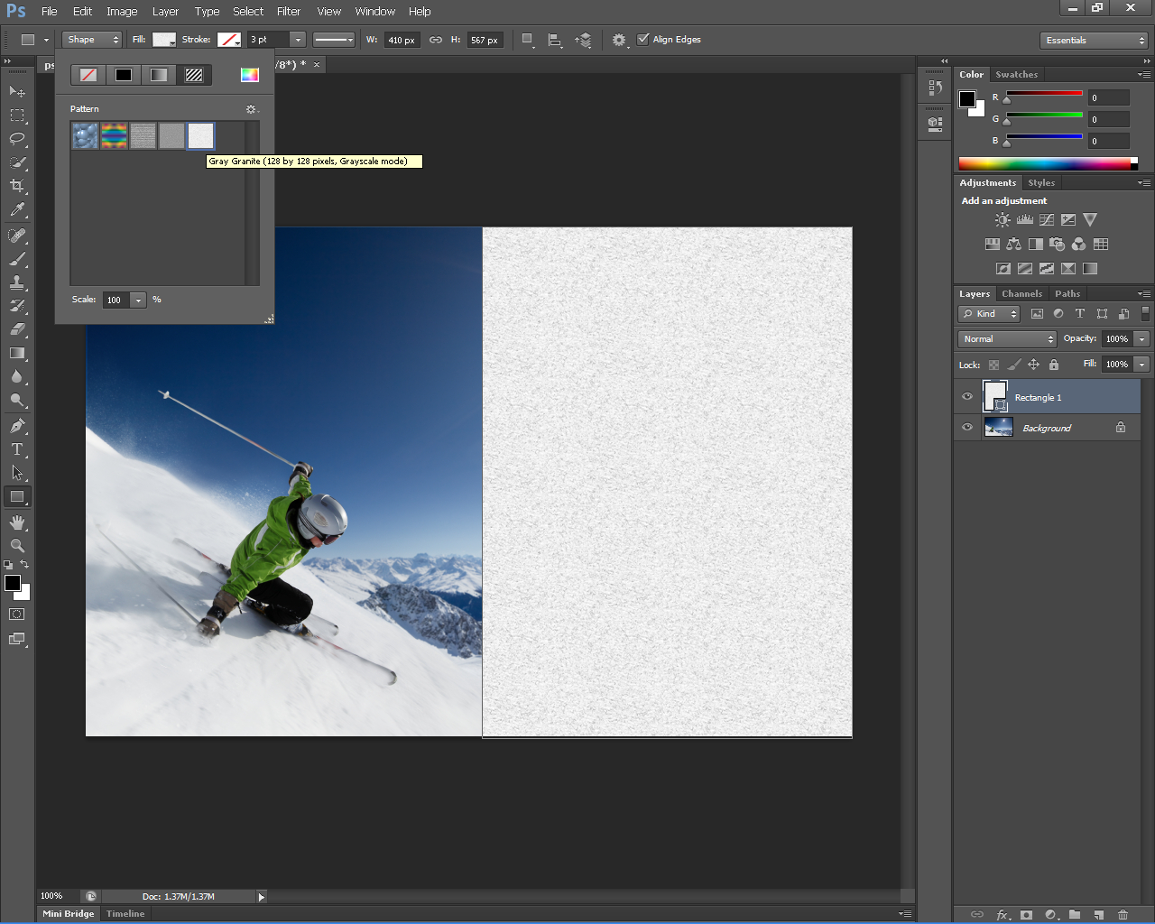
Vector Capabilities
Select rectangle tool -> click and drag to create a large rectangle over the right half of the image
Click fill in option bar ->click pattern button -> select grey granite as pattern

Slide 4
Click and hold rectangle tool-> select hidden shape tool
Click arrow in shape drop-down menu -> click gear icon -> select nature category, when warning box comes up click append.

Slide 5
Select snowflake 1
Click path operations-> subtract front shape
Put your mouse on the left side of the rectangle shape, press and hold Alt key-> click and drag to create large snowflake shape from the center.
Use path selection tool to move snowflake to middle

Slide 6
Adding a mask to a Vector Layer
Select add layer button at the bottom of layers panel
Select gradient tool form tools panel and click and drag from right side of snowflake towards center of snowflake.

Slide 7
Using new brush tips
Select background in layers panel, press and hold Alt key and click create new layer button
Type Strokes in name text field

Slide 8
Select Brush tool -> then select window> brush; the brush panel appears
Click the airbrush labeled 80-> enter these settings
Change the flow to 25% and click the enable airbrush –style build up effects.
Press x to swap the foreground and Background color so that white is foreward.
Start painting snow flying behind the skier .

Slide 9
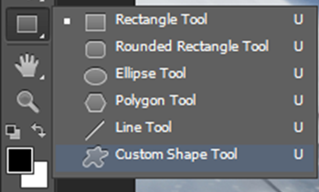
To save the new brush, click the new icon (bottom right of brush panel)
Name it my brush, then click ok
Choose file save and keep the page open
Select rectangle 1 layer
Click custom shape tool from tools panel
Click shape drop-down menu, on right side of options bar, select snowflake 3
Click image area once insert width of 60px and click ok .

Slide 10
Click fill in options bar, and select no color icon
Click stroke and select 50% Grey color swatch
Change stroke size to 2pts
Hide path view-> show -> target path or ctrl+shift+H
Select stroke type in options bar then click more options
Change following : select center from align drop down menu , make sure Round is selected for both the caps and Corners and enter the first four values as 2, click ok .
Save this file and keep it open

Slide 11
Select the move tool place the cursor over the snowflake, hold alt click and drag to make another snow flake (in the layers panel you will see a new layer called shape 1 copy)
Repeat this step with the next snowflake until you have 4 snowflakes
In layers panel click the top layer called shape 1 copy 3 and then shift+click the layer called shape 1. (all layers selected)
Press Ctrl+E to merge layers , then select path selection tool and move snowflakes where you want them, click a snowflake and press Ctrl+T , grab corners to resize snowflakes however you want press enter when done resizing

Slide 12
Adding text files from another document
Choose file -> open then browse and select ps0102.psd
Click the pure text layer then shift click powder text layer to select both layers.
Right click on the right side of either layer and then select duplicate layers from the contextual menu that appears.
Select ps0101_work.psd from the document drop-down menu.
Ps0101_work.psd

Slide 13
Then return to ps0101_work.psd file, then select type tool (T), click text that says “Pure”, press Ctrl+A
Text is already set to myriad pro, in the set the font style drop-down menu, select bold.
Now decrease the spacing between each letter by pressing Alt and the left arrow key to decrease spacing or right arrow key to increase spacing
Select window -> paragraph styles click new paragraph styles button
Double click paragraph style 1
Change name to Headline and click ok
Make sure you still have type tool clicked then select powder text area to change text attributes.
Change color of text by double click headline text style to open options dialogue box, click color field at bottom, cursor is now eyedropper, choose the light gray color from the snow and click ok.

