Slide 1
Lesson 4
Photoshop Basics

Slide 2
What you’ll learn
Combining images
Understanding document settings
Removing backgrounds
Saving files

Slide 3
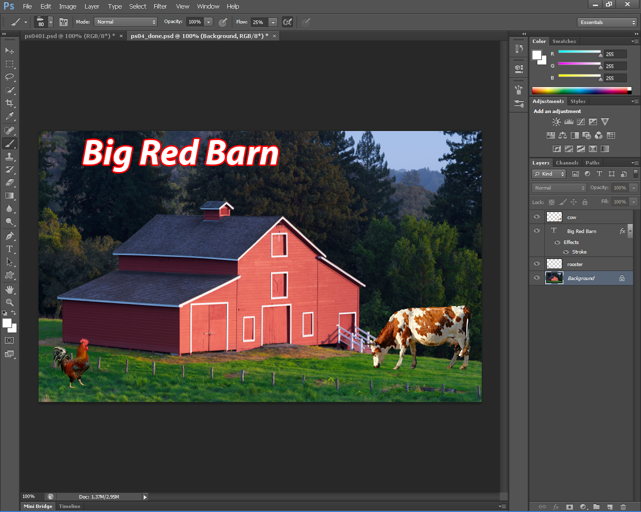
What you will create in Photoshop

Slide 4
First
1.
Open Photoshop
Go to file>browse in bridge
Go to lesson 4 folder
Hold down the Ctrl key and select all 4 folders in the lesson
Right click>open
3.
2.
4.

Slide 5
Rooster
Click the rooster tab to bring up the picture of the rooster.
Now the image is to big to combine with the barn, so click Image>image size
Next you are going to change the height to 200 pixels in the pixel dimension box. Make sure the constrain proportions and Resample Image is checked. Click OK.

Slide 6
Using copy and paste
Now you are going to add the rooster image into the barn image.
First, make sure you are still on the rooster tab
Second, go to select>All
Third, choose Edit>Copy, the image is now in your clipboard.
Fourth, click the Barn tab, go to Edit>Paste, your rooster is now in the barn picture.
Last, go to the rooster tab and close it…DO NOT save any changes.

Slide 7
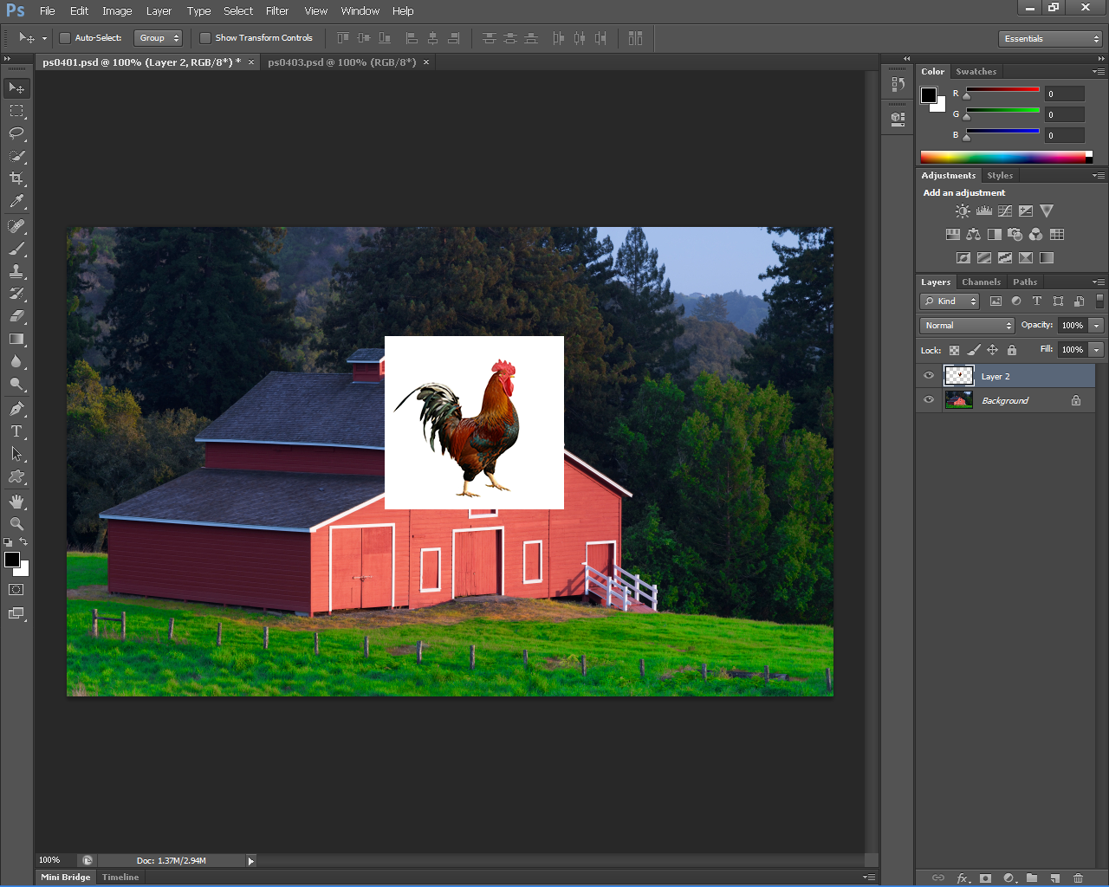
So far this is what you should have!

Slide 8
A Faster Way To Copy!
Select the move tool, hold on the left mouse button and drag the image up to the barn tab, the screen will switch over and then release the mouse.
Your image will be in the new tab.
Do this to the cow image!
Resize the cow image so you can see everything
Close the cow tab.

Slide 9
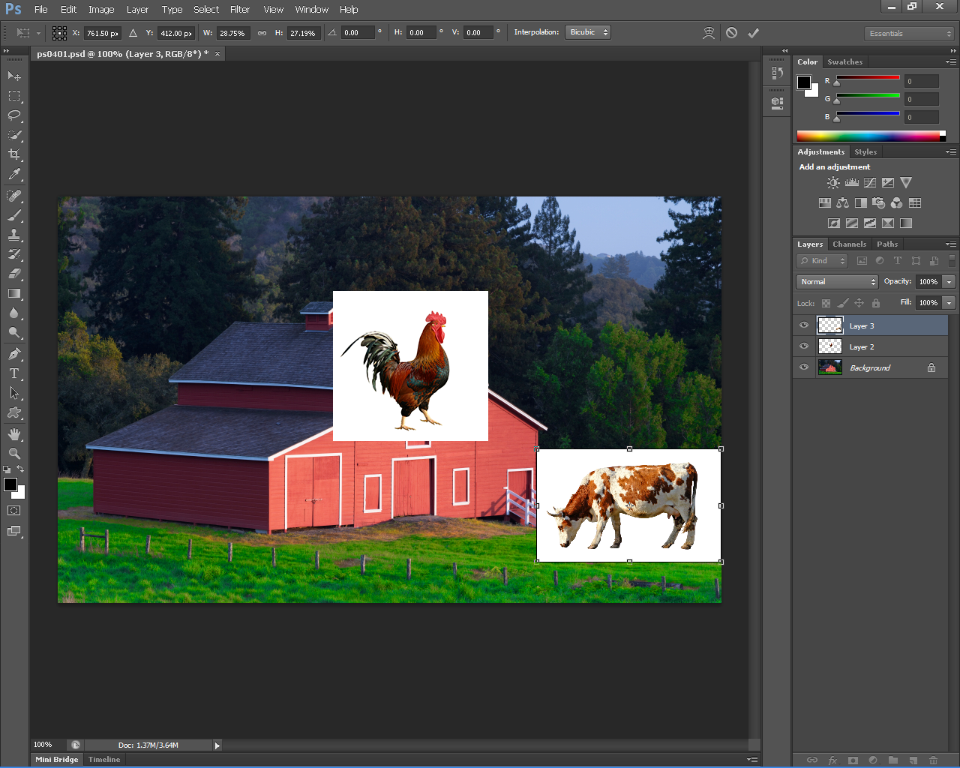
Your page should look like this!

Slide 10
It’s time to remove the backgrounds!
First, select the cow layer, then click the magic eraser tool. (you will have to right click on the eraser tool to access this)
Now just place the MET on the cows white background and click. The background should disappear…if it doesn’t make sure you are in the cow layer (on the side panel)
Do this to the rooster also!

Slide 11
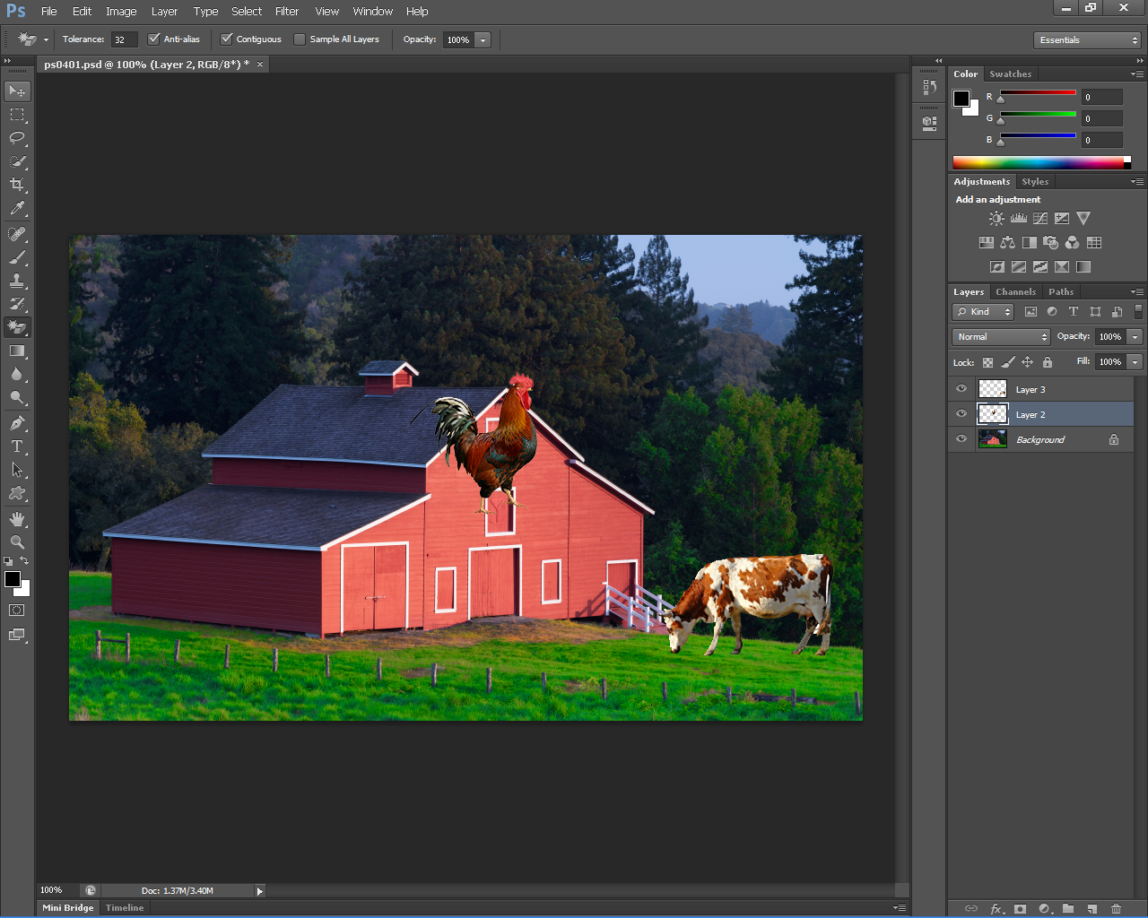
Does yours look like this?? If so you are right on track!

Slide 12
Understanding stacking of layers
“Layers are like pieces of clear film that you can place on a table. The layers themselves are clear, but anything placed on one of the layers will be positioned on top of the layers that are beneath it.”
First, make sure the rooster layer is selected, select the move tool.
Click and hold the rooster, drag it to the lower-left corner of the image, in front of the fence and along the side of the barn.
Click the cow layer and using the move tool drag the cow image to the lower right corner of the image. (make it look like its eating the grass)
Choose file>save.

Slide 13
Refining the edges of copied images
Select the cow layer
Zoom in on the cow
Choose layer> matting > defringe ( keep default settings) The defringe command blends the edges of the layer into the background, making it appear more natural
Do the same for the rooster
Press CTRL + Z to undo the defringe command
Save your work
Your work should look like this so far

Slide 14
Adding text
Select the rooster layer
Select the type tool and click just above the barn.
In the options bar select
Myriad pro (or whatever you like)
Bold italic
Font size 72
Pick a light color for your text
Type Big Red Barn, when you're done click on the Commit checkbox to confirm text.
With the text layer still active, click the add layer style button (fx) , choose stroke.
Save your work.

Slide 15
Your work should resemble this.

Slide 16
You have completed lesson 4!!!!

