Slide 1
Adobe Photoshop Lesson 3
By Gus Born

Slide 2
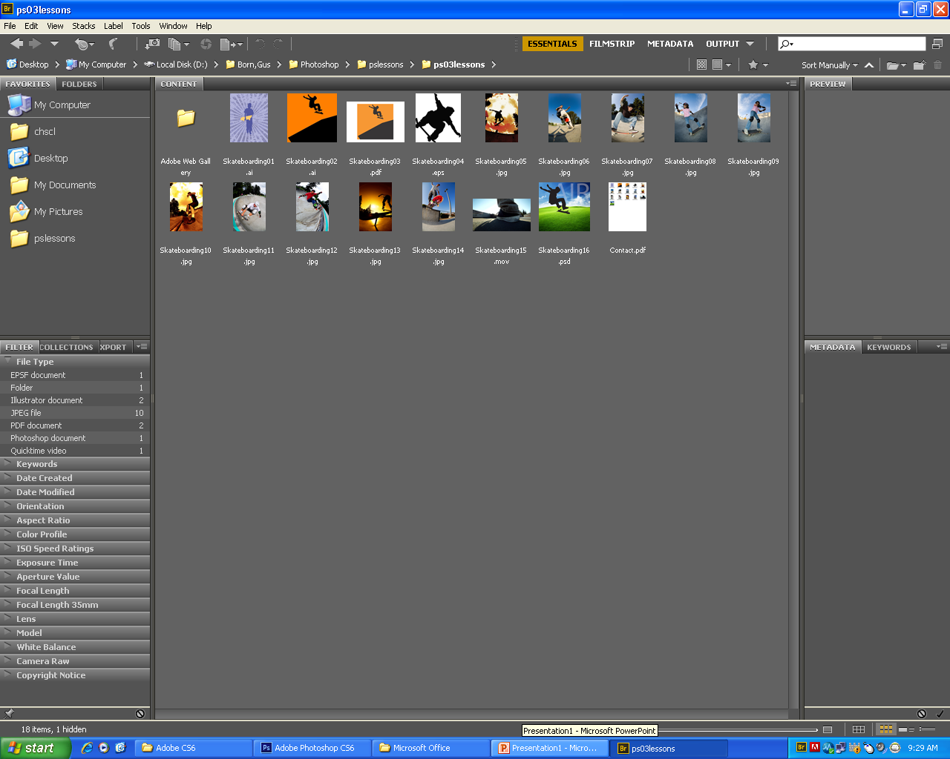
Navigating Through Bridge
In Photoshop Choose
File> Browse in Bridge
Click on favorites Panel to make sure it is forward. Click on desktop. (make sure it is saved to the hard drive to your folder)
Click on ps03lesson folder and the contents of the folder should be displayed in the middle.

Slide 3
Using folders in Adobe Bridge
Click on the tab of the favorites panel In the upper left corner of the bridge window to make sure it is still forward. Then click on the left arrow to the left of Desktop so that it turns downward and reveals its contents.
Click on the computer to reveal its contents in the center pane of the Bridge window continue clicking to reveal the contents.

Slide 4
Using folders in Adobe Bridge
Click on Desktop in the folders panel to reveal its contents again
Click on ps03lessons to view its contents. You will now make a new folder
Click on the create a new folder icon in the upper-right of the Bridge window to create a untitled folder type the name Graphics
Click and drag in to folder.

Slide 5
Making a favorite
Select the favorites panel and make the Graphics folder a Favorite.
Click and drag the graphics folder in to the favorites panel.

Slide 6
Creating and locating metadata
Window>Workspace>Reset workplace
Click on a image and look at bottom right for metadata and keywords panels.
Find image iStock_1771975.jpg
In the metadata locate description writer type your name. In Description text field type Skateboarder Catching Air
Click apply

Slide 7
Using Keywords
Click on keywords tab
Click new keywords type skateboarder
With skateboarder still selected click new sub keyword type male then press enter.
Check the checkbox left of skateboarder
Select skateboarder and new keyword button type sunset and enter the check the box right click on sunset rename the word sunset to orange. Press enter.

Slide 8
Creating a metadata template
Make sure that your image is selected in Bridge.
Tools> Create Metadata Template name file sunset skateboarders.
Check the boxes that say Creator, Creator: city, Creator: State/Province, Description, Keywords, Description Writer then save.
Select one image then press and hold Ctrl and both images are selected.
Tools>Append Metadata and select sunset skateboarders

Slide 9
Searching by name or keyword
Make sure your still viewing the correct folder
Edit>Find or Ctrl+F
Type Skateboarder into the 3rd text field then press enter.
Clear the search by pressing the x icon near the new search button

Slide 10
Saving a collection
If the collections tab to the right is not visible Window>Collections Panel
Click in the gray area and the click the New Collection button type Redmond skateboarding press enter to confirm
Go back to the folder and take two random images and drag them into the collection

Slide 11
Batch renaming your files.
Go back arrow in the upper left of the adobe bridge window.
Edit> Select all
Tools> Batch Rename
In the new files name type skateboard in the text field to the right of criteria
Sequence row select two digits
Confirm sequence number is starting at 1
If there is any other criteria click on the minus sign
Press rename and look to see if the images are renamed

Slide 12
Changing the view
Before experimenting with the views make sure that you are in the essentials workspace
Click on the Lock to Thumbnail grid Button
Now click on the view content as detail button
Choose the view content as list
Choose the view content as thumbnails.

